Slide 1

Dynamic 3D Structure enriched by H3K27ac and H3K27me3 and Gene Regulation of Drosophila under Heat Stress
Presenter: Yin Pengfei
Instructor: Zheng Meizhen
Time: 2024 March 26th

Slide 2
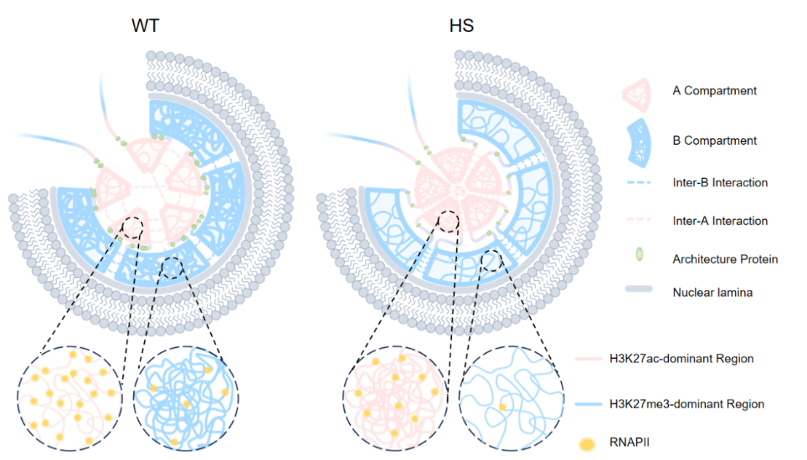
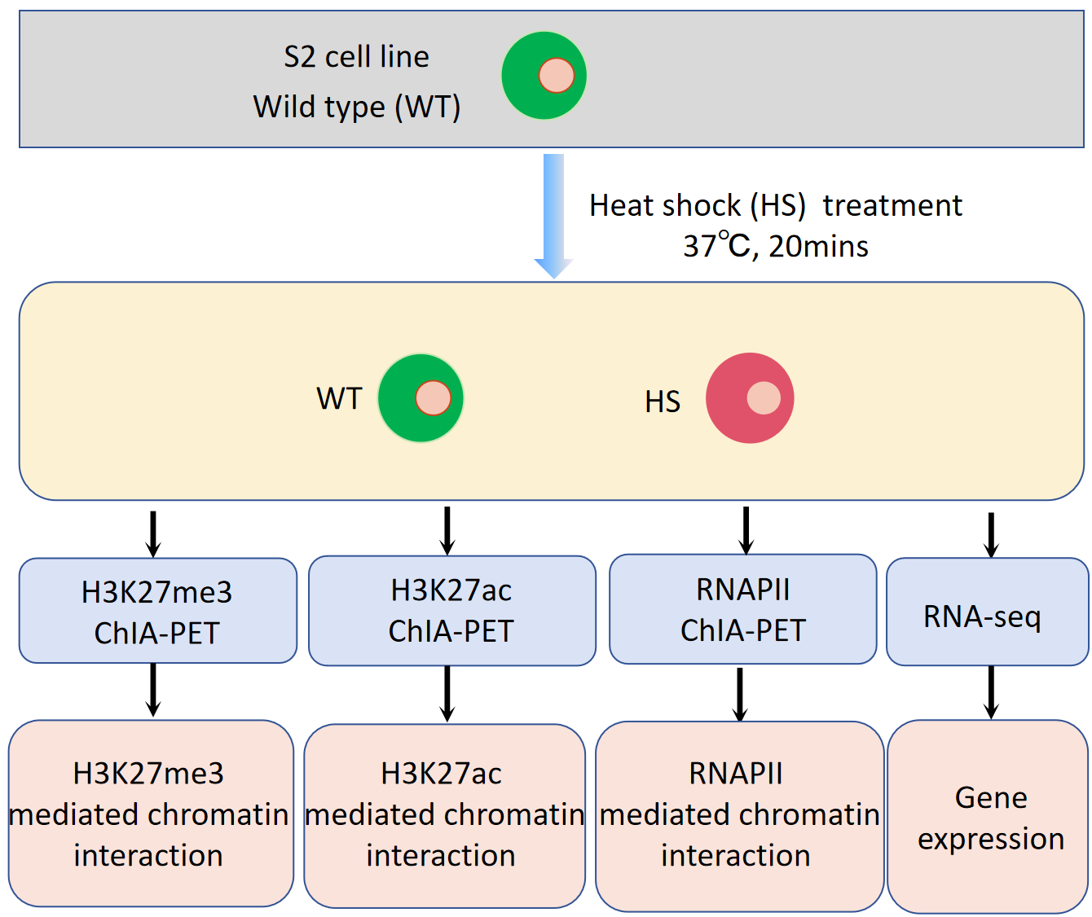
Summary
Dynamic 3D structure of Droshophila under heat stress
Introduction
Li et al., Molecular Cell. 2015 and Ray et al., PNAS. 2019 have applied Hi-C to study the dynamic 3D structure of Droshophila under heat stress. The genome consists of active and inactive regions, but how active (H3K27ac) and inactive (H3K27me3) regions are functionally changed in 3D chromatin architecture in response to environmental stresses are poorly understood. ChIA-PET can be used to enrich interaction mediated by H3K27ac and H3K27me3 respectively which are mixed in Hi-C data.
Model
Heat shock
Project design
H3K27me3: inactive histone mark
H3K27ac: active histone mark
RNAPII: transcriptional machinery protein
RNA-seq: mark the gene expression level
1. After HS, interaction inside TADs and B compartments decrease, while interaction inside A compartments increase. Besides, interaction between adjacent TADs and adjacent B compartments both increases. Combined with the fact that some TADs share the boundaries with B compartments, we can guess that the interaction’s decrease insides B compartments may share the mechanism with TADs, that after HS, architecture proteins (APs) redistribute from the TAD boundaries to the inside of TADs and TAD boundaries weaken.
2. After HS, H3K27ac_ChIA-PET produce more obvious stripes, while H3K27me3_ChIA-PET produce more obvious block between adjacent B compartments. Combined with that fact that A compartments correspond to euchromatin located inside the nucleus, while B compartments correspond to heterochromatin, primarily located at the nuclear periphery and around the nucleolus. We can reasonably speculate that the increase of inter-B is caused by the redistribution of APs, while the increase of inter-A is caused by the closer spatial distance of clustered A compartments.
3. Interaction mediated by RNAPII drops more inside B compartments than that inside A compartments. Combined with the fact that heat shock can result in the increased release of bound RNAPII from DNA, we an reasonably speculate that after heat shock larger proportion of RNAPII in B compartments releases from DNA.
Conclusions
1. Our study showed that heat shock can induce lots of loops with low PET counts and large loop span connecting different H3K27ac-dominant regions. Further analysis demonstrated that H3K27ac-dominant and H3K27me3-dominant regions highly align with A and B compartments respectively.
2. After heat shock, while interaction strength inside A compartments increases, interaction strength inside B compartments decreases. Besides, interaction mediated by RNAPII drops more inside B compartments than that inside A compartments, which aligns with the finding that down-regulated genes are more likely to be found in B compartments.
3. After heat shock, A compartments in hubs become even closer or form new larger hubs, while adjacent B compartments have stronger interaction. (Its relationship with gene expression and regulation is still under exploration)
4. After heat shock, TAD boundaries weaken while TAD number and TAD size remain largely unchanged. Proportion of loops with large loop span increases. Changes observed at the TAD level support the findings presented in Li’s 2015 Molecular Cell paper, while the conclusions drawn in Ray’s PNAS paper diverge from these findings. Besides, dynamic TADs called using RNAPII_ChIA-PET correlate with DEGs, and these DEGs are involved in RNA metabolism and the cellular response to stress.
5. In summary, we propose a model of dynamic 3D structures at the levels of A/B compartments and TADs,along with gene regulation patterns, in response to heat stress in Drosophila.
Li et al., Molecular Cell. 2015
Oudelaar et al., Nature Reviews Genetics. 2021
Hieda et al., Chromosome Res. 2005
Teves et al., Genes Dev. 2011
Green denotes the observation from our data, while purple denotes some conclusions from other publications.

Slide 3
Background
Brief introduction to 3D genomics
Brief introduction to heat stress

Slide 4
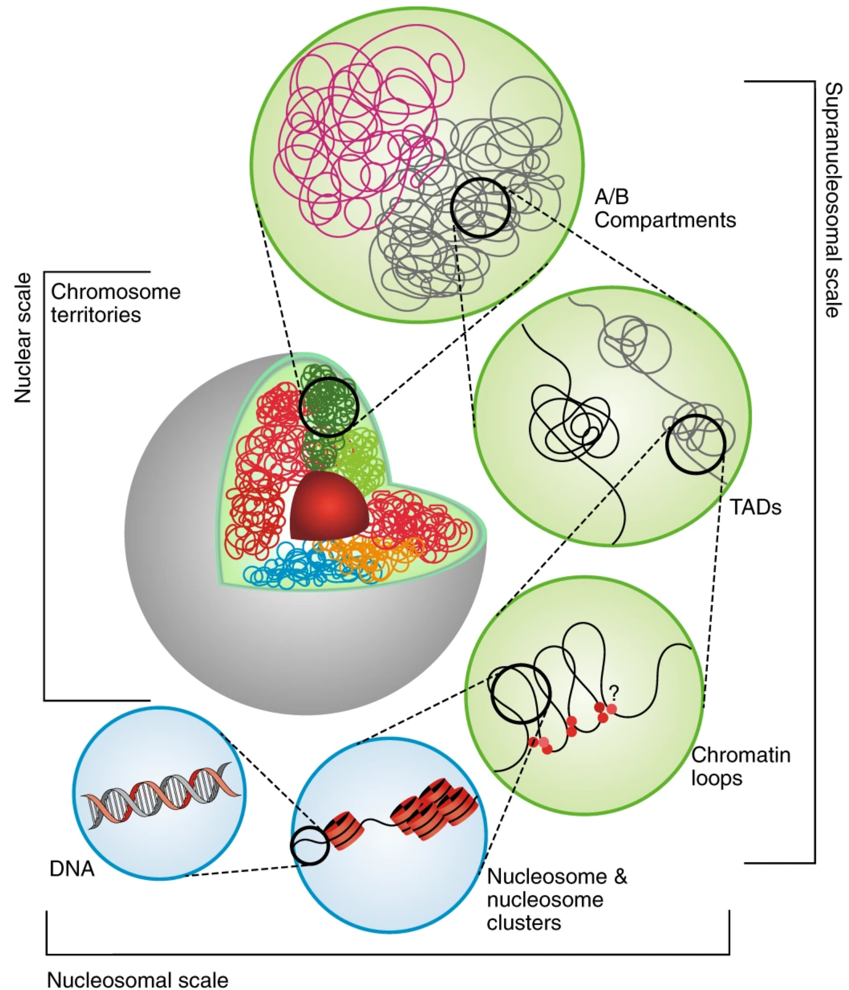
Background
3D genomics, a new branch of epigenetics
The essence: how the 3D genome is organized into multiple layers and how this organization influences gene expression and regulation.
Doğan et al., Nature Plants. 2018

Slide 5
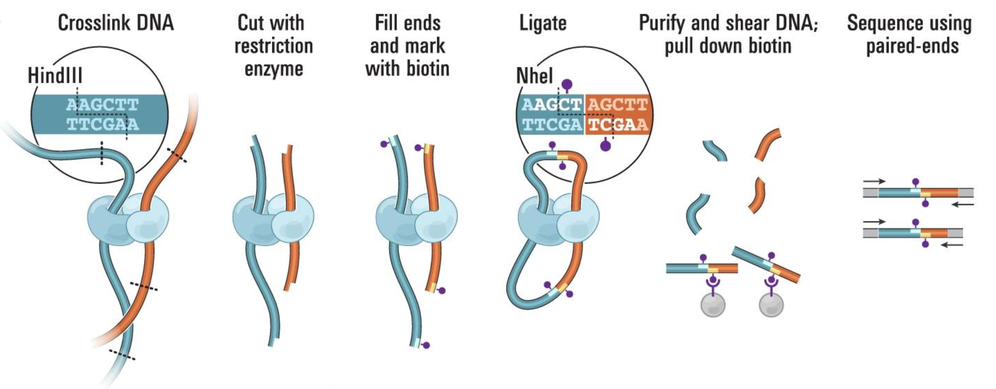
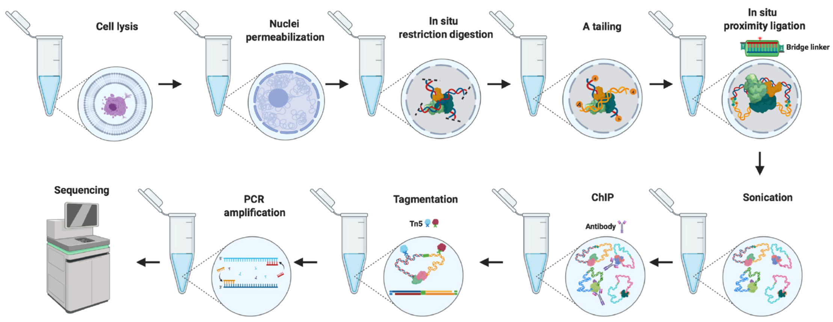
Background
Commonly used techniques in 3D genomics
Commonly used sequencing-based techniques in 3D genomics
Hi-C captures all the interactions, while ChIA-PET captures the interactions mediated by some factor.
Erez et al., Science. 2009
Hi-C
Rusk et al., Nature Methods. 2009
Wang et al., Curr Protoc. 2021
in situ ChIA-PET

Slide 6
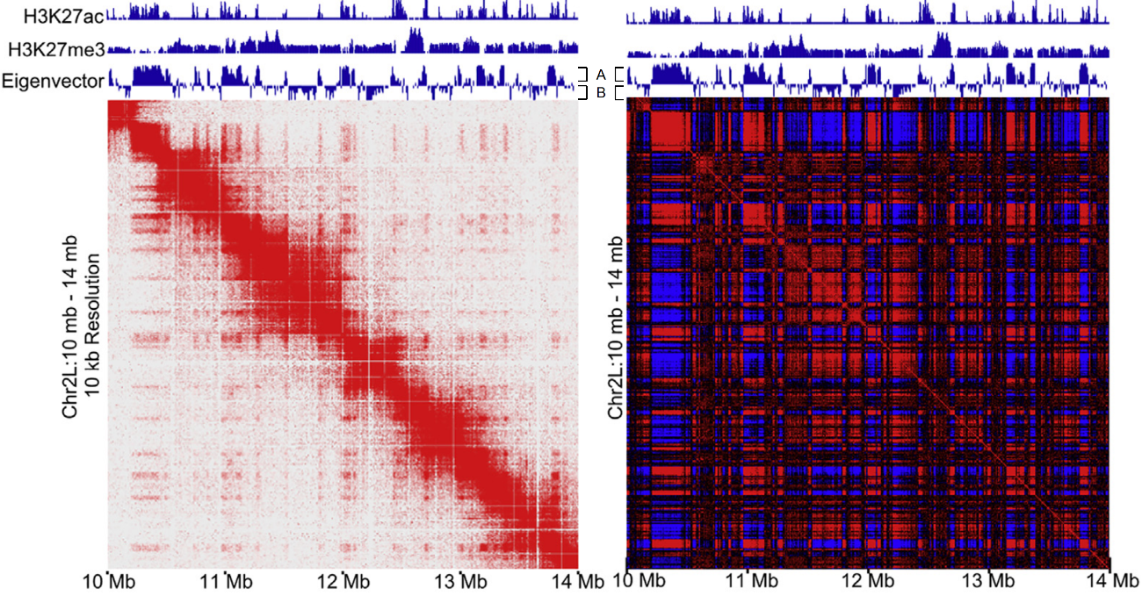
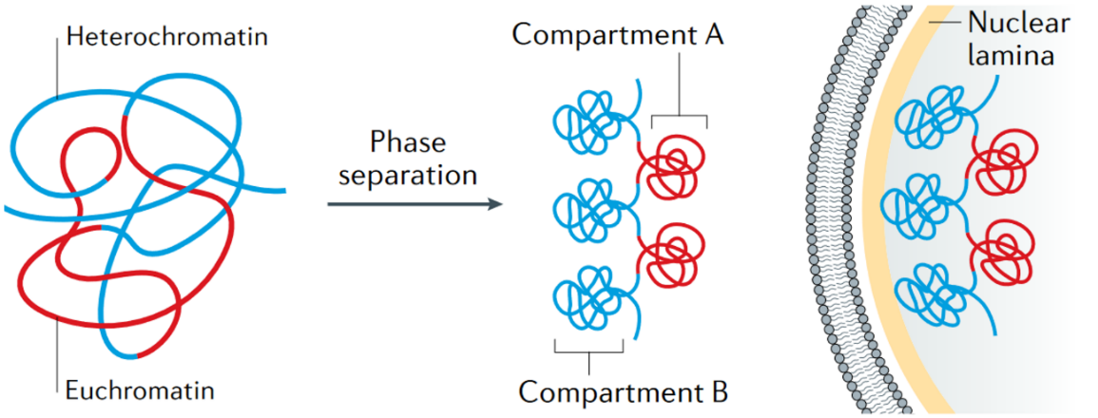
Background
A/B compartments
1. A/B compartments show as a 'checkerboard' pattern.
2. A compartments are prone to interact with A compartments, while B compartments are prone to interact with B compartments.
Adapted from Rowley et al., Molecular cell. 2017
3. A compartments correspond to euchromatin located inside the nucleus, while B compartments correspond to heterochromatin, primarily located at the nuclear periphery and around the nucleolus.
4. Phase separation (related to epigenetic modifications) is an important driving force for chromatin compartmentalization.
Oudelaar et al., Nature Reviews Genetics. 2021

Slide 7
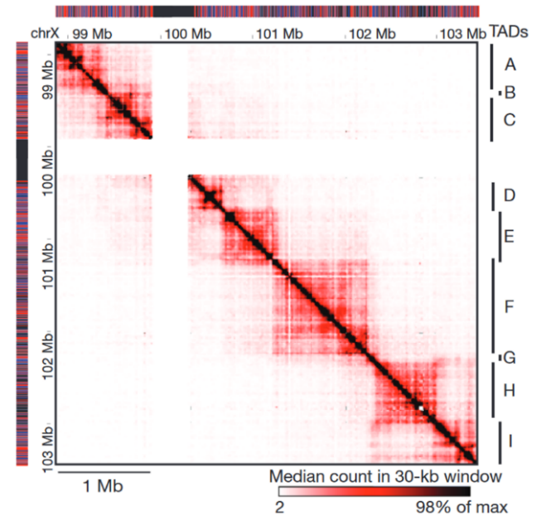
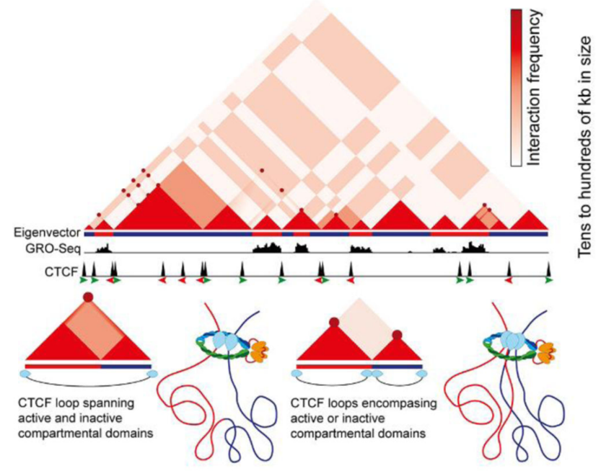
Background
TADs (Topologically associated domains)
1. TADs are the square regions located on the diagonal, with higher interaction frequency inside the square regions.
2. TAD boundaries in mammalian cells enrich convergent CFCT binding sites. (TAD boundaries in Droshophlia enrich BEAF-32/CP190).
3. Loop extrusion is a promising mechanism to explain the formation of TADs
4. TADs and A/B compartments are distinct chromosomal structures; however, they share some interrelated features (overlapped and nested)
that are currently under investigation.
Nora et al., Nature. 2012
Jordan et al., Nature Reviews Genetics. 2018

Slide 8
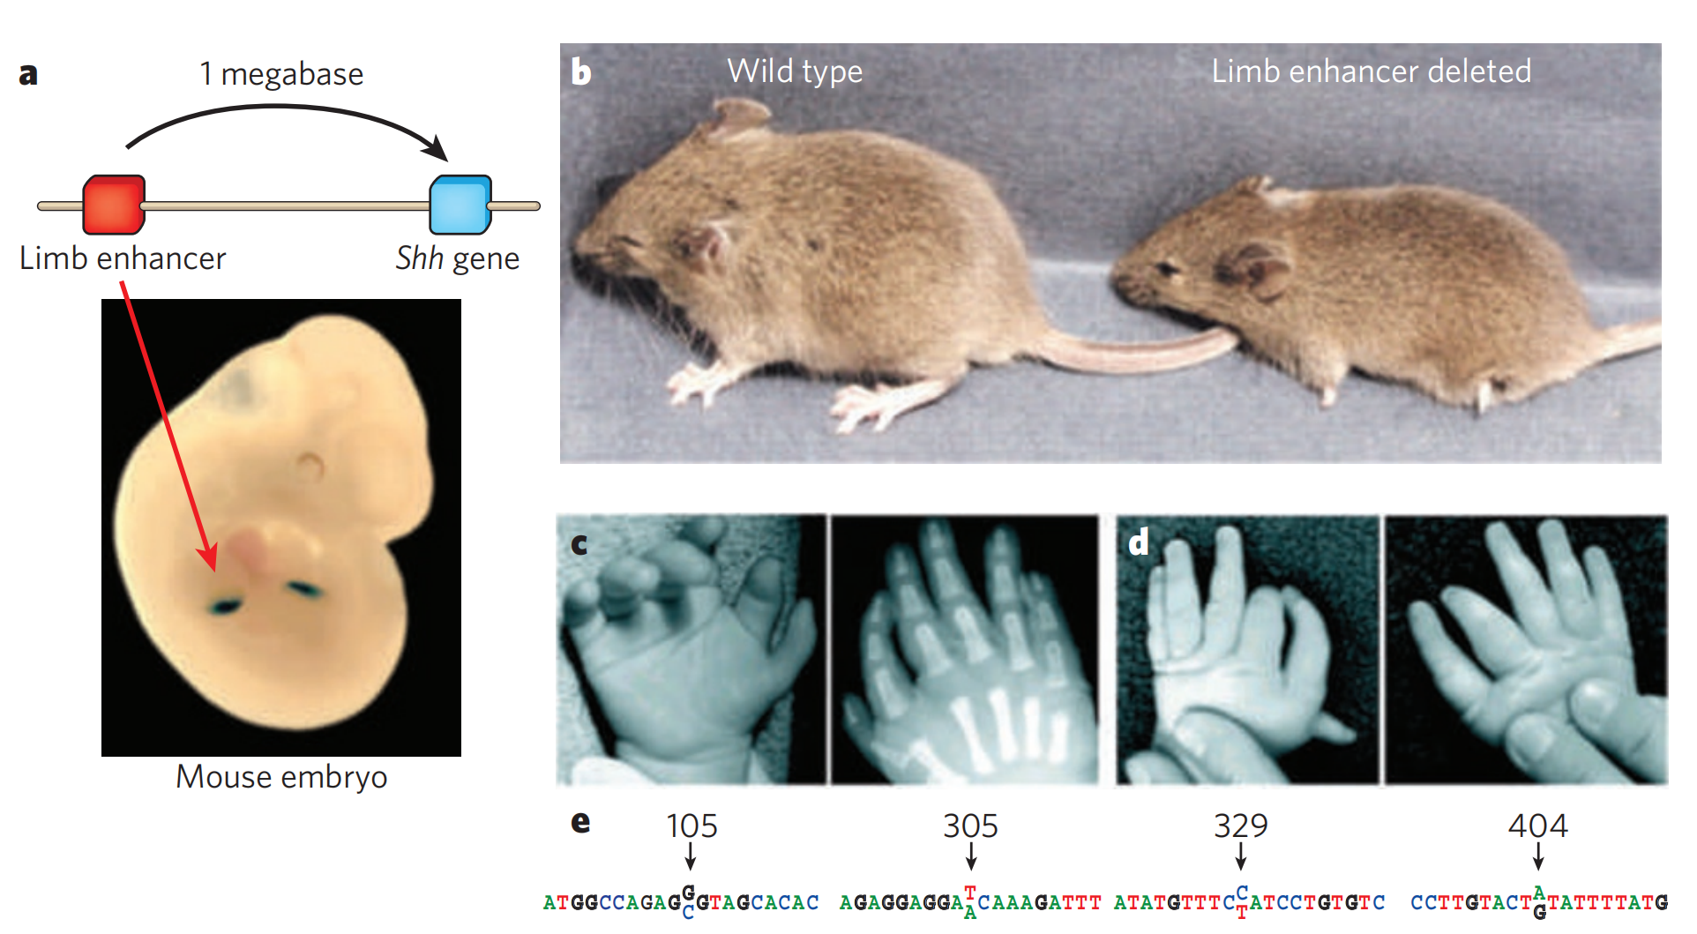
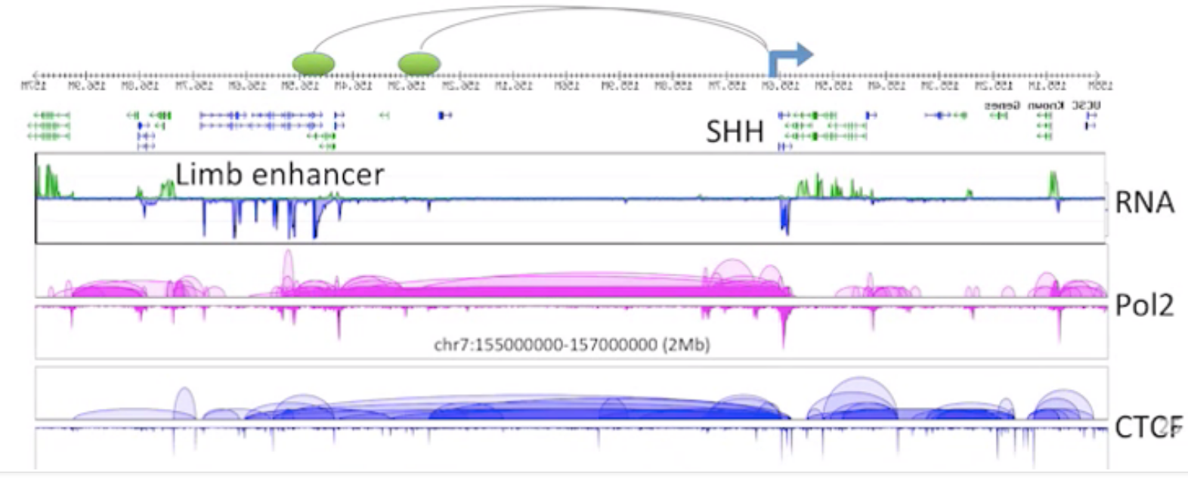
Background
Loops
Visel et al., Nature. 2009
Limb enhancer and shh gene are spatially close
Shh
RNA-seq
Limb enhancer
ChIA-PET RNAPII
chr7:155000000-157000000(2Mb)
ChIA-PET CTCF
From Yijun Lab

Slide 9
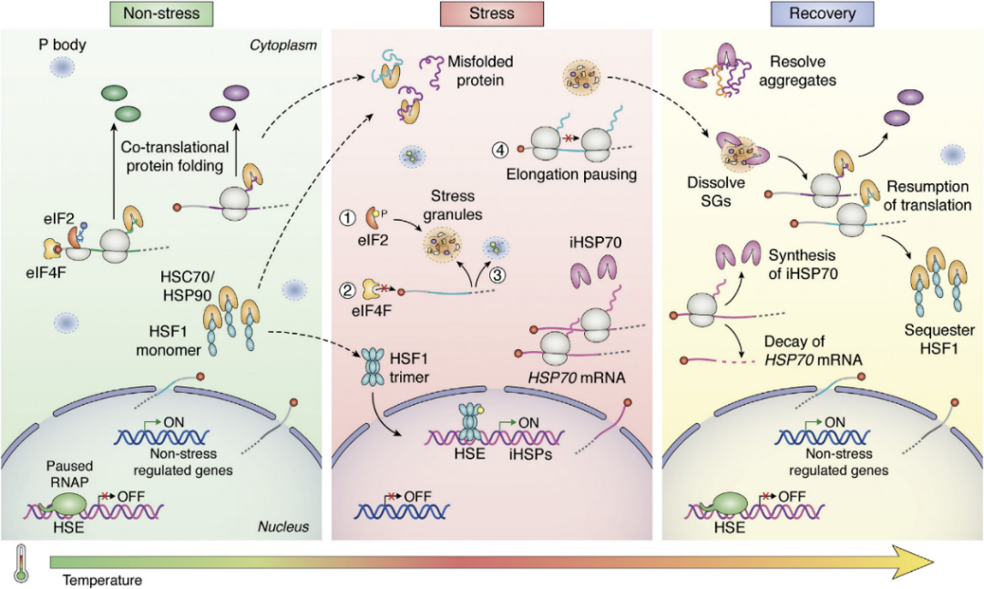
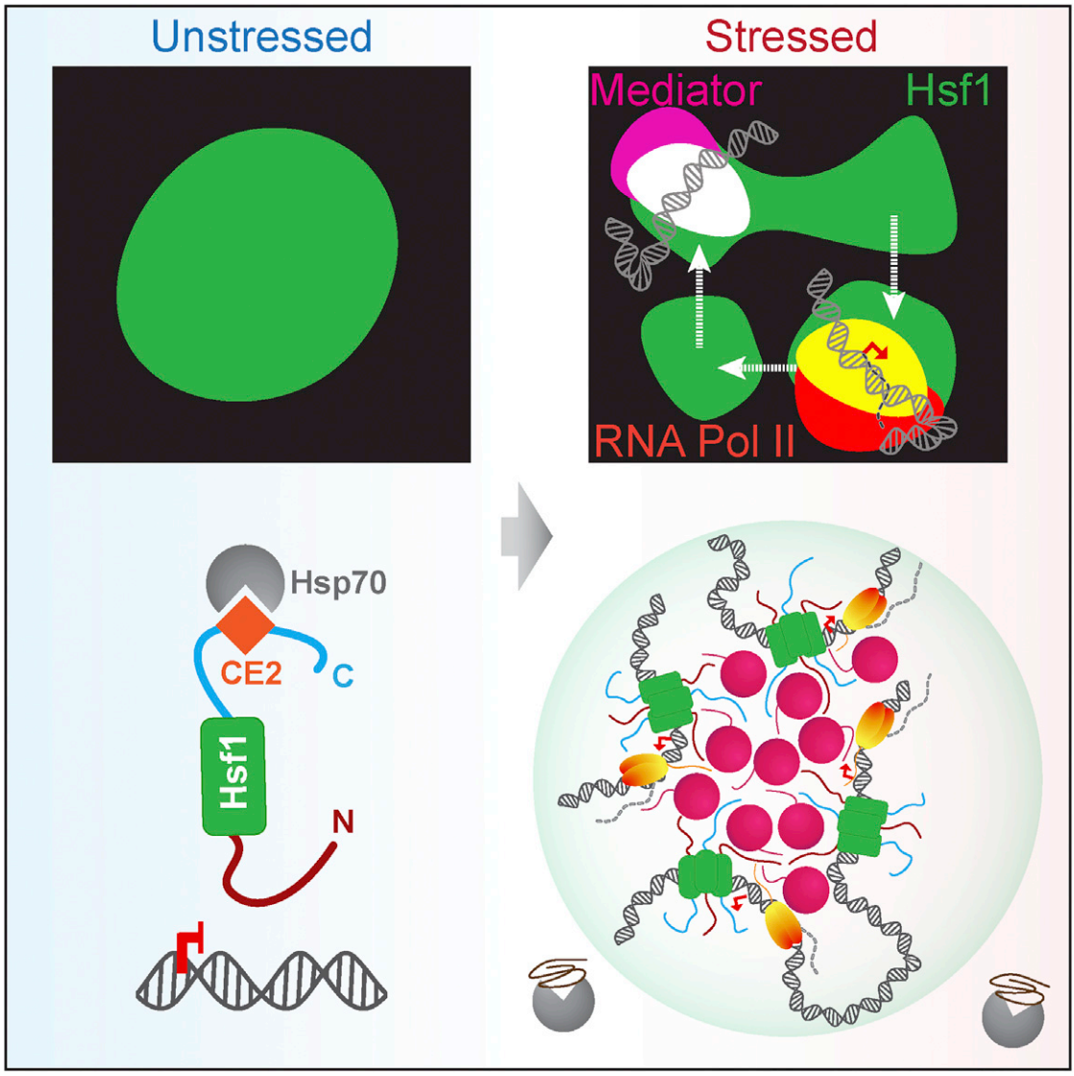
Background
Heat stress
1. Heat shock can have some typical genes highly expressed like Hsp70 in Drosophila.
2. After heat shock, there are thousands of up-regulated and down-regulated genes in Drosophila.
3. Heat shock can result in the increased release of bound RNAPII from DNA.
4. Heat shock can induce biomolecular condensates.
5. Hsf1 (usually located in H3K27ac regions), together with Mediator and Pol II, forms dynamic transcriptional condensates to drive 3D genome reorganization during stress
Li et al., Molecular Cell. 2015
Hieda et al., Chromosome Res. 2005
Teves et al., Genes Dev. 2011
Boopathy et al., Journal of Biological Chemistry. 2022
Chowdhary et al., Molecular Cell. 2022

Slide 10
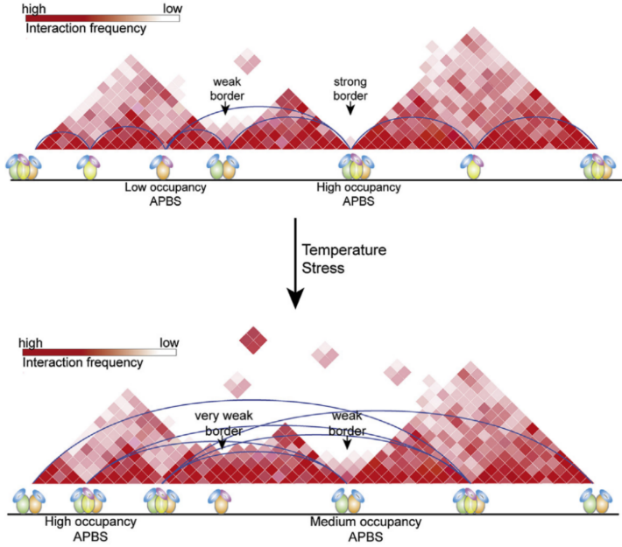
Background
Dynamic changes of 3D structure under heat stress
After HS, architecture proteins (APs) redistribute from the TAD boundaries to the inside of TADs. TAD boundaries weaken and the proportion of loops with a large span increases.
Li et al., Molecular Cell. 2015

Slide 11
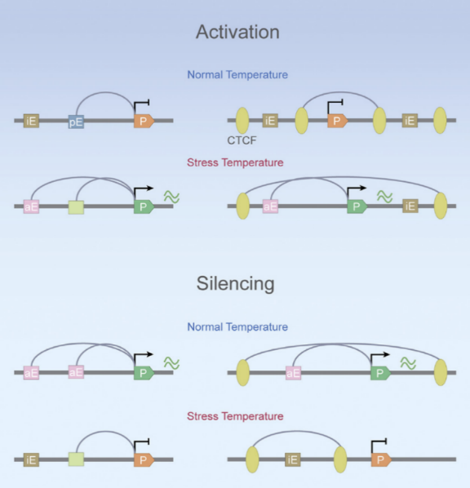
Background
Dynamic changes of 3D structure under heat stress
After HS, loops can randomly extrude to regulate the gene expression
Lyu et al., Molecular Cell. 2018

Slide 12
Project design

Slide 13
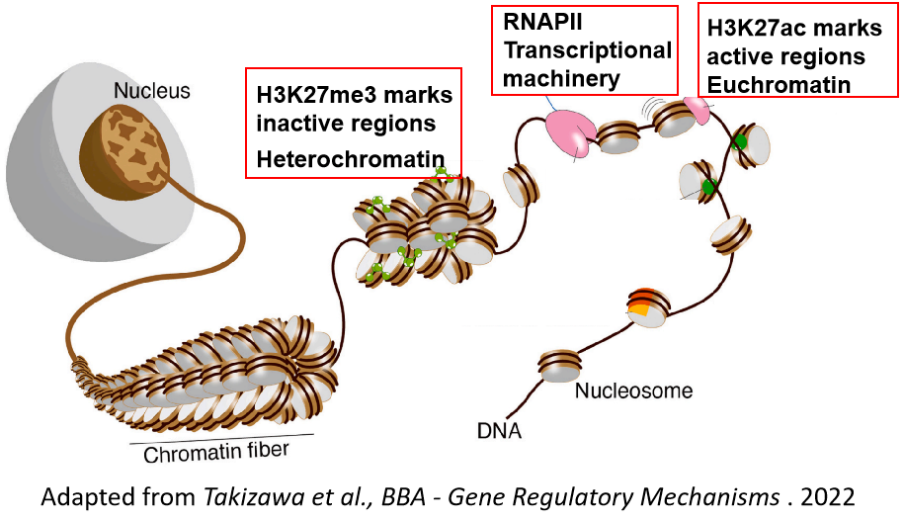
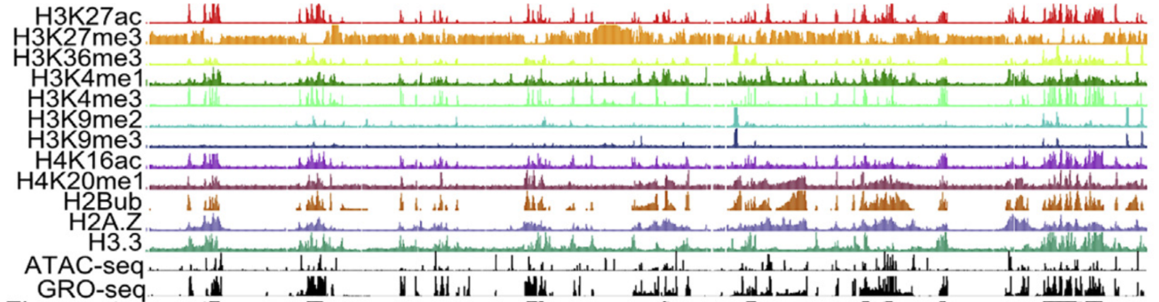
Project design
S2 cell line
Wild type (WT)
Heat shock (HS) treatment
37℃, 20mins
WT
HS
H3K27me3 ChIA-PET
H3K27ac ChIA-PET
RNAPII
ChIA-PET
RNA-seq
H3K27me3 mediated chromatin interaction
H3K27ac
mediated chromatin interaction
RNAPII
mediated chromatin interaction
Gene expression
Rowley et al., Molecular Cell. 2017
H3K27me3: inactive histone mark
H3K27ac: active histone mark
RNAPII: transcriptional machinery protein
RNA-seq: mark the gene expression level

Slide 14

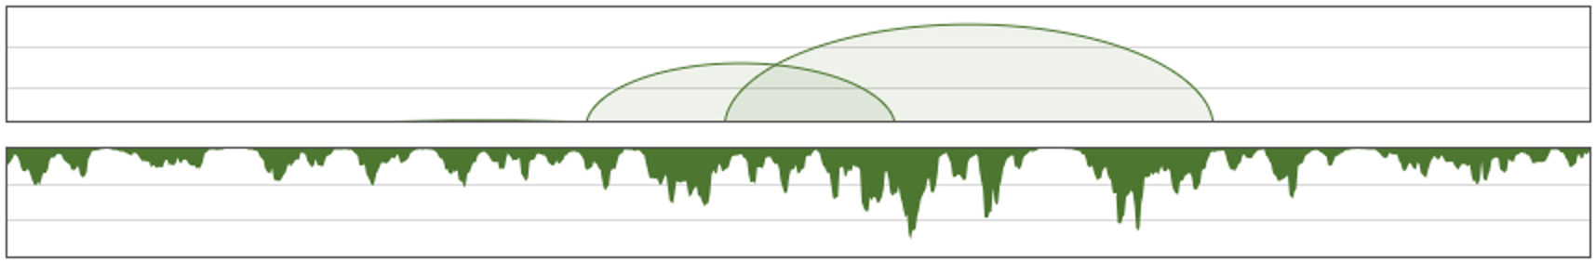
Project design
S2 cell line
Wild type (WT)
Data format produced by ChIA-PET
Heat shock (HS) treatment
37℃, 20mins
Hi-C matrix
Loops and coverage
RNA-seq
loops
WT
HS
coverage
H3K27me3 ChIA-PET
H3K27ac ChIA-PET
RNAPII
ChIA-PET
RNA-seq
Compartments/TADs
Interaction domains/Loops
H3K27me3 mediated chromatin interaction
H3K27ac
mediated chromatin interaction
RNAPII
mediated chromatin interaction
Gene expression
Changes at different levels of 3D structure
induced by heat shock
Rowley et al., Molecular Cell. 2017
H3K27me3: inactive histone mark
H3K27ac: active histone mark
RNAPII: transcriptional machinery protein
RNA-seq: mark the gene expression level
Dynamic 3D structure and gene regulation of Drosophila under heat stress

Slide 15
Data quality
Successful heat shock treatment
Reproducibility of ChIA-PET libraries

Slide 16
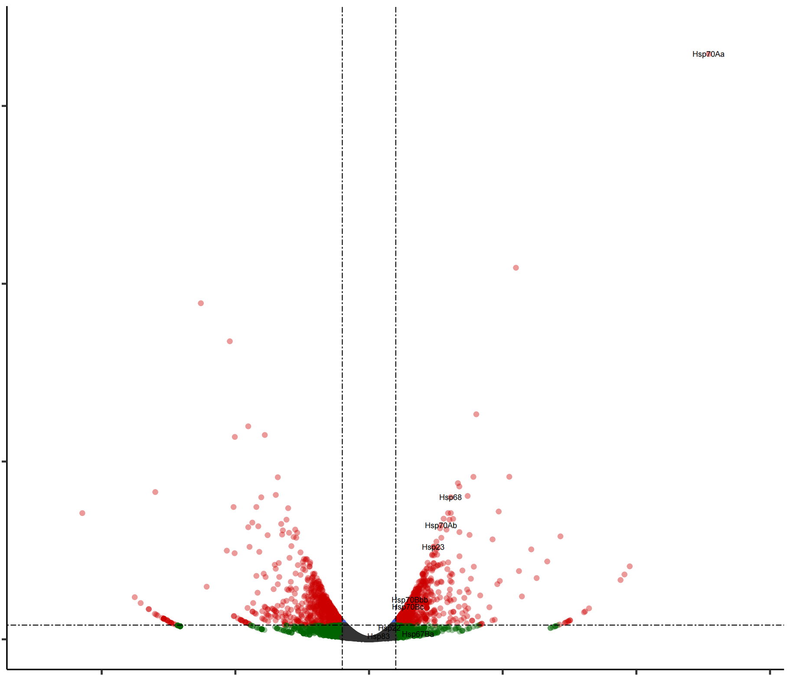
Data quality
Typical DEGs related to heat shock show the success of heat shock treatment
Hsp70Aa
-Log₁₀ FDR
0 50 100 150
Hsp68
Hsp70Ab
Hsp23
Hsp70Bbb
Hsp70Bc
-10 -5 -1 0 1 5 10 15
Log₂ FC
expressed n= 8270
up-regulated n= 1054
down-regulated n= 988
Produced by Deng Yuqing and Yin Pengfei

Slide 17
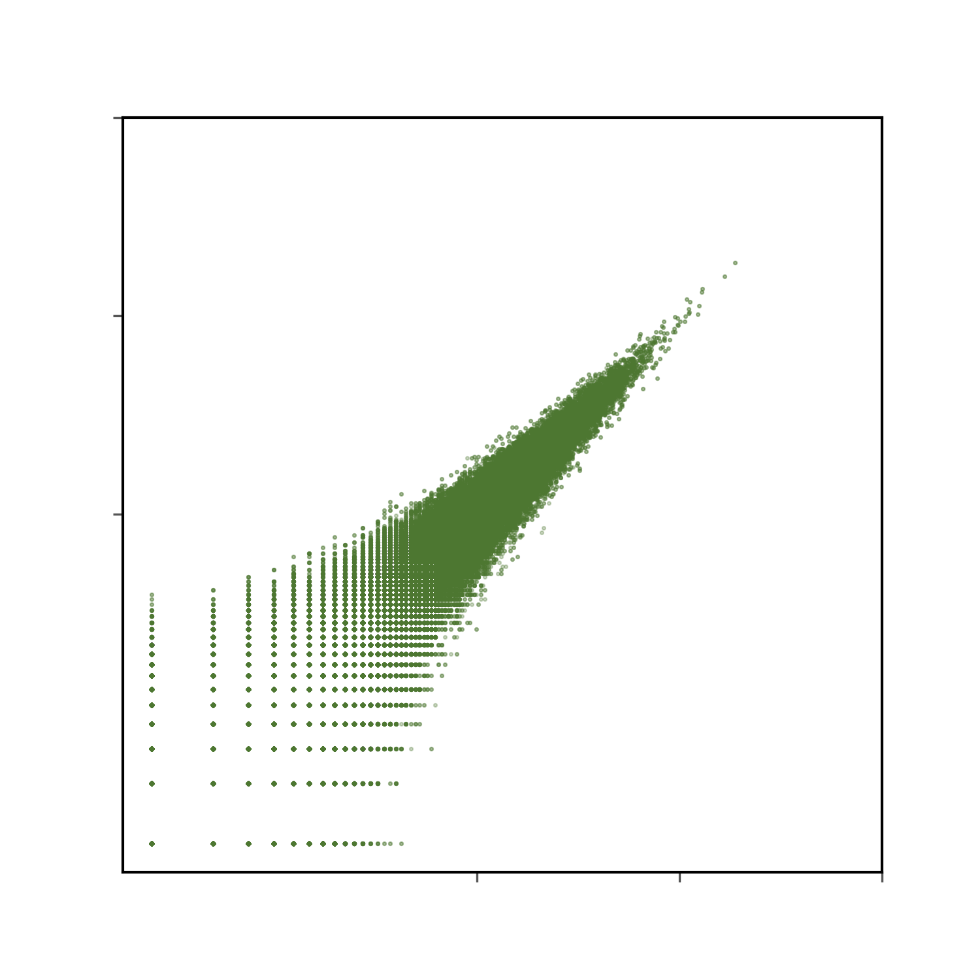
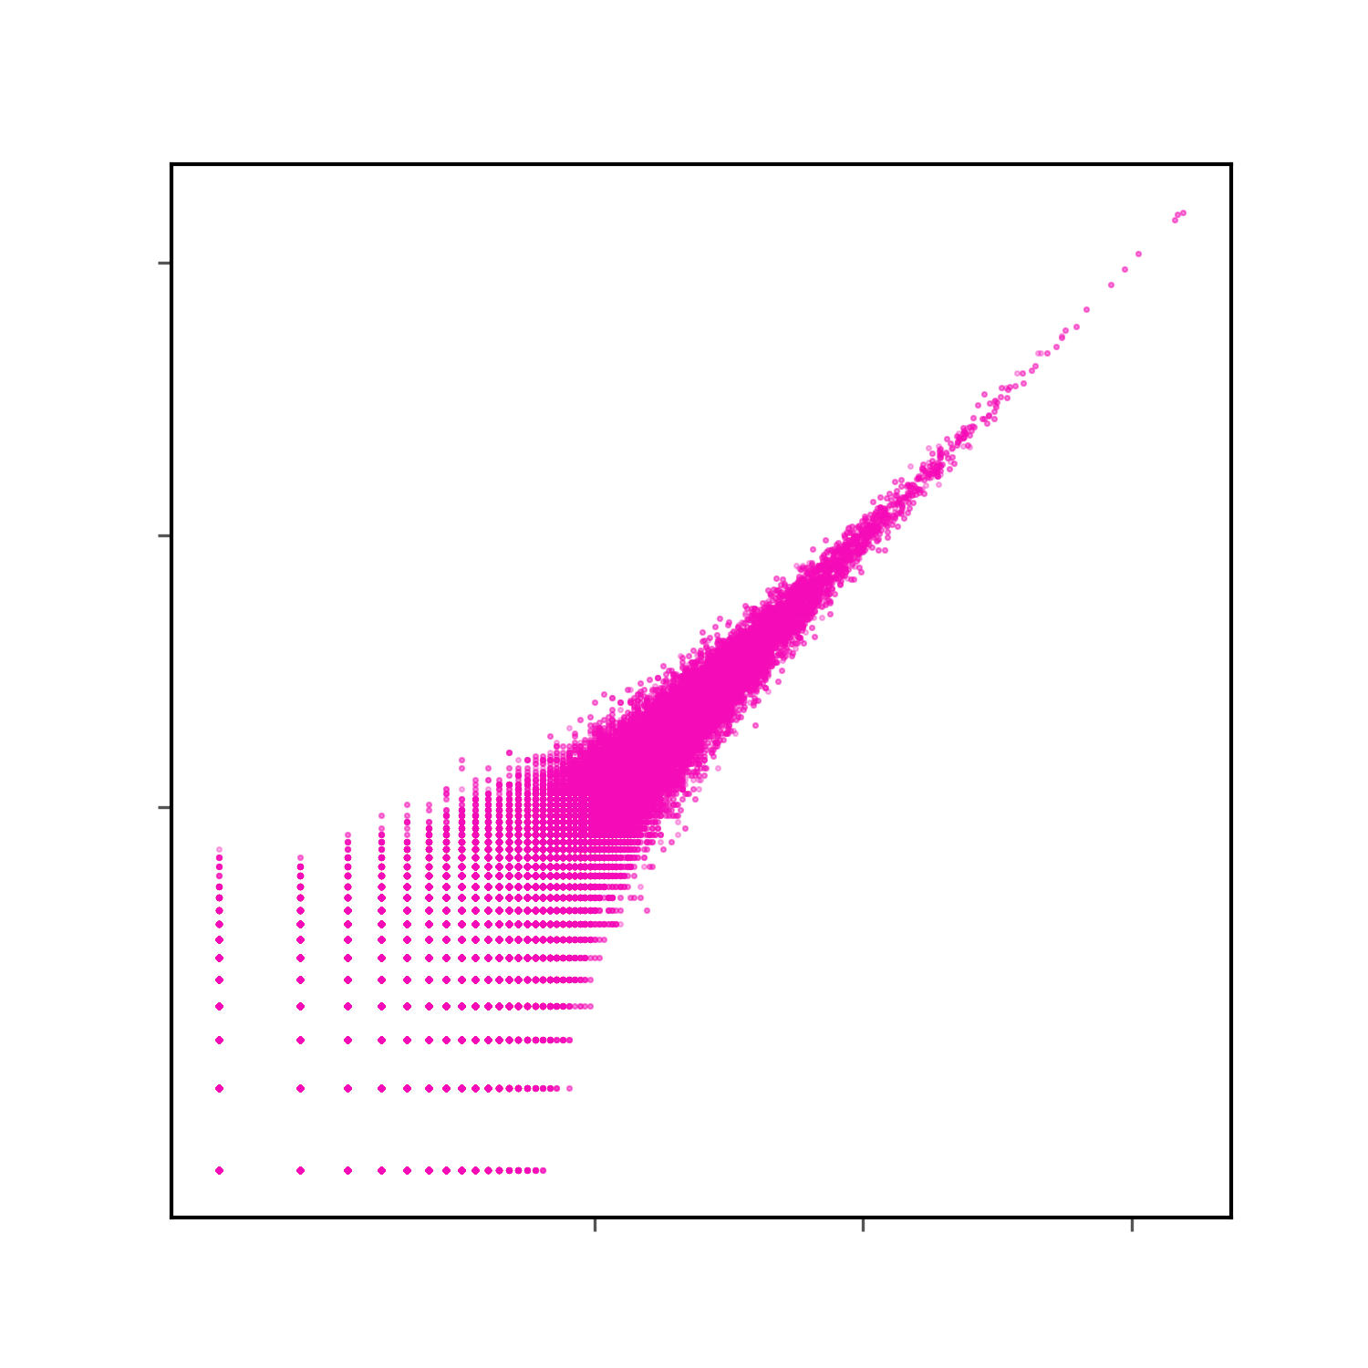
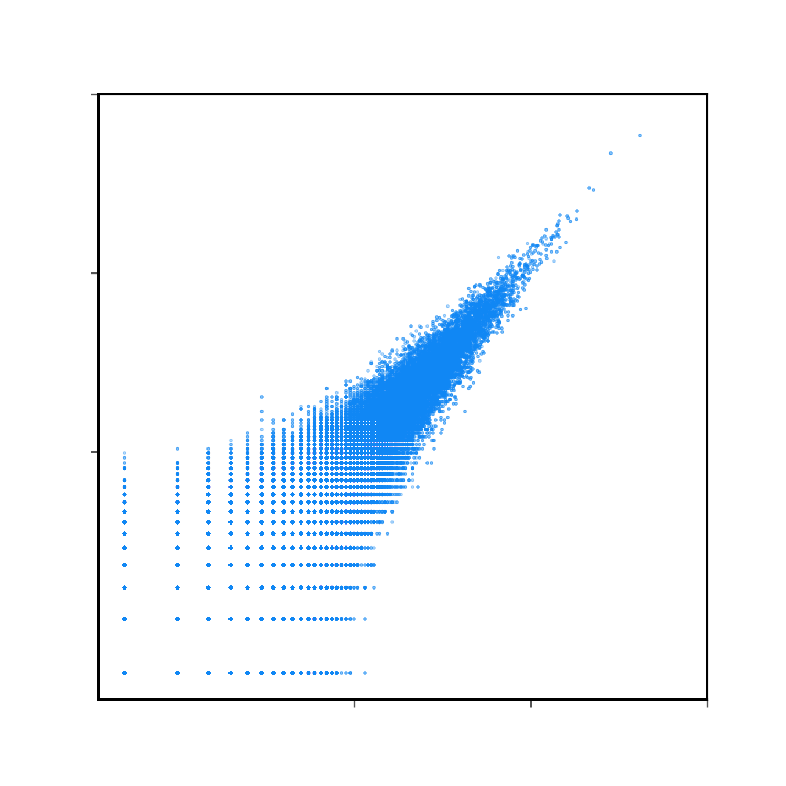


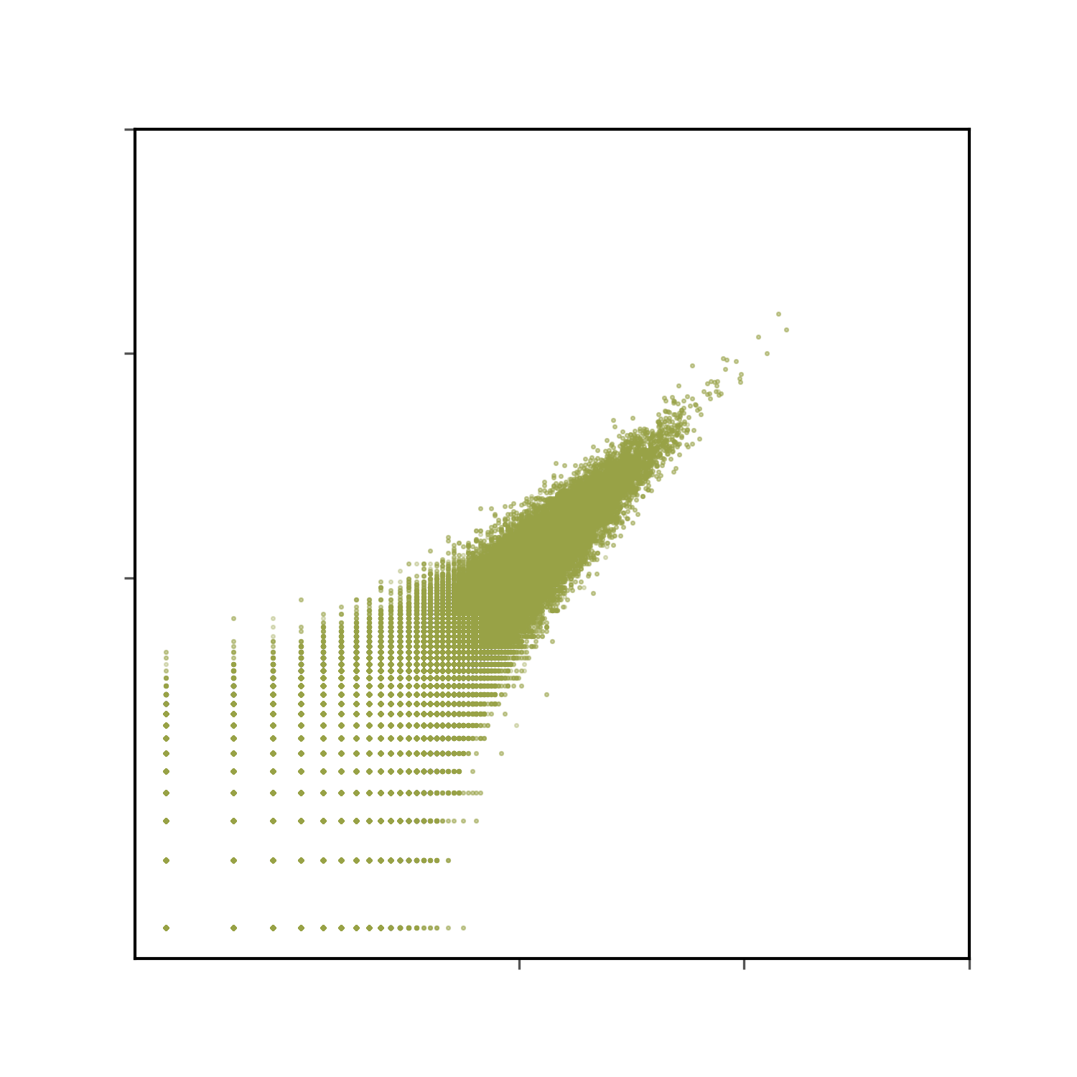

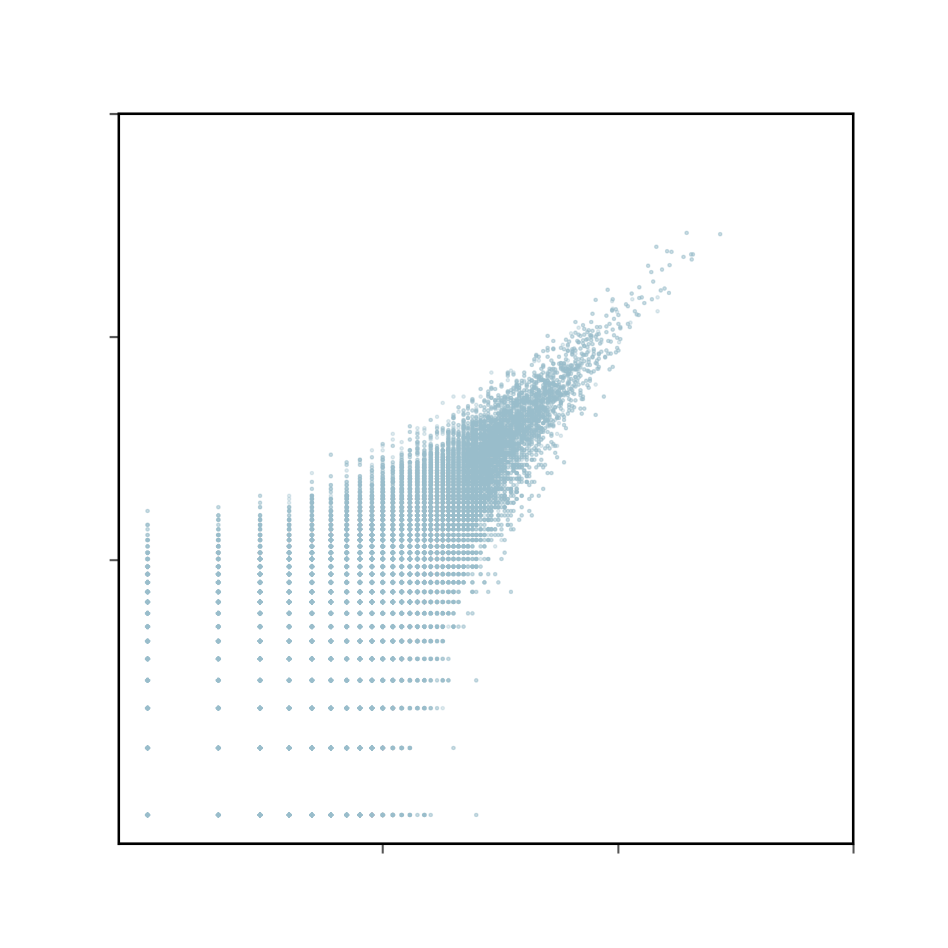
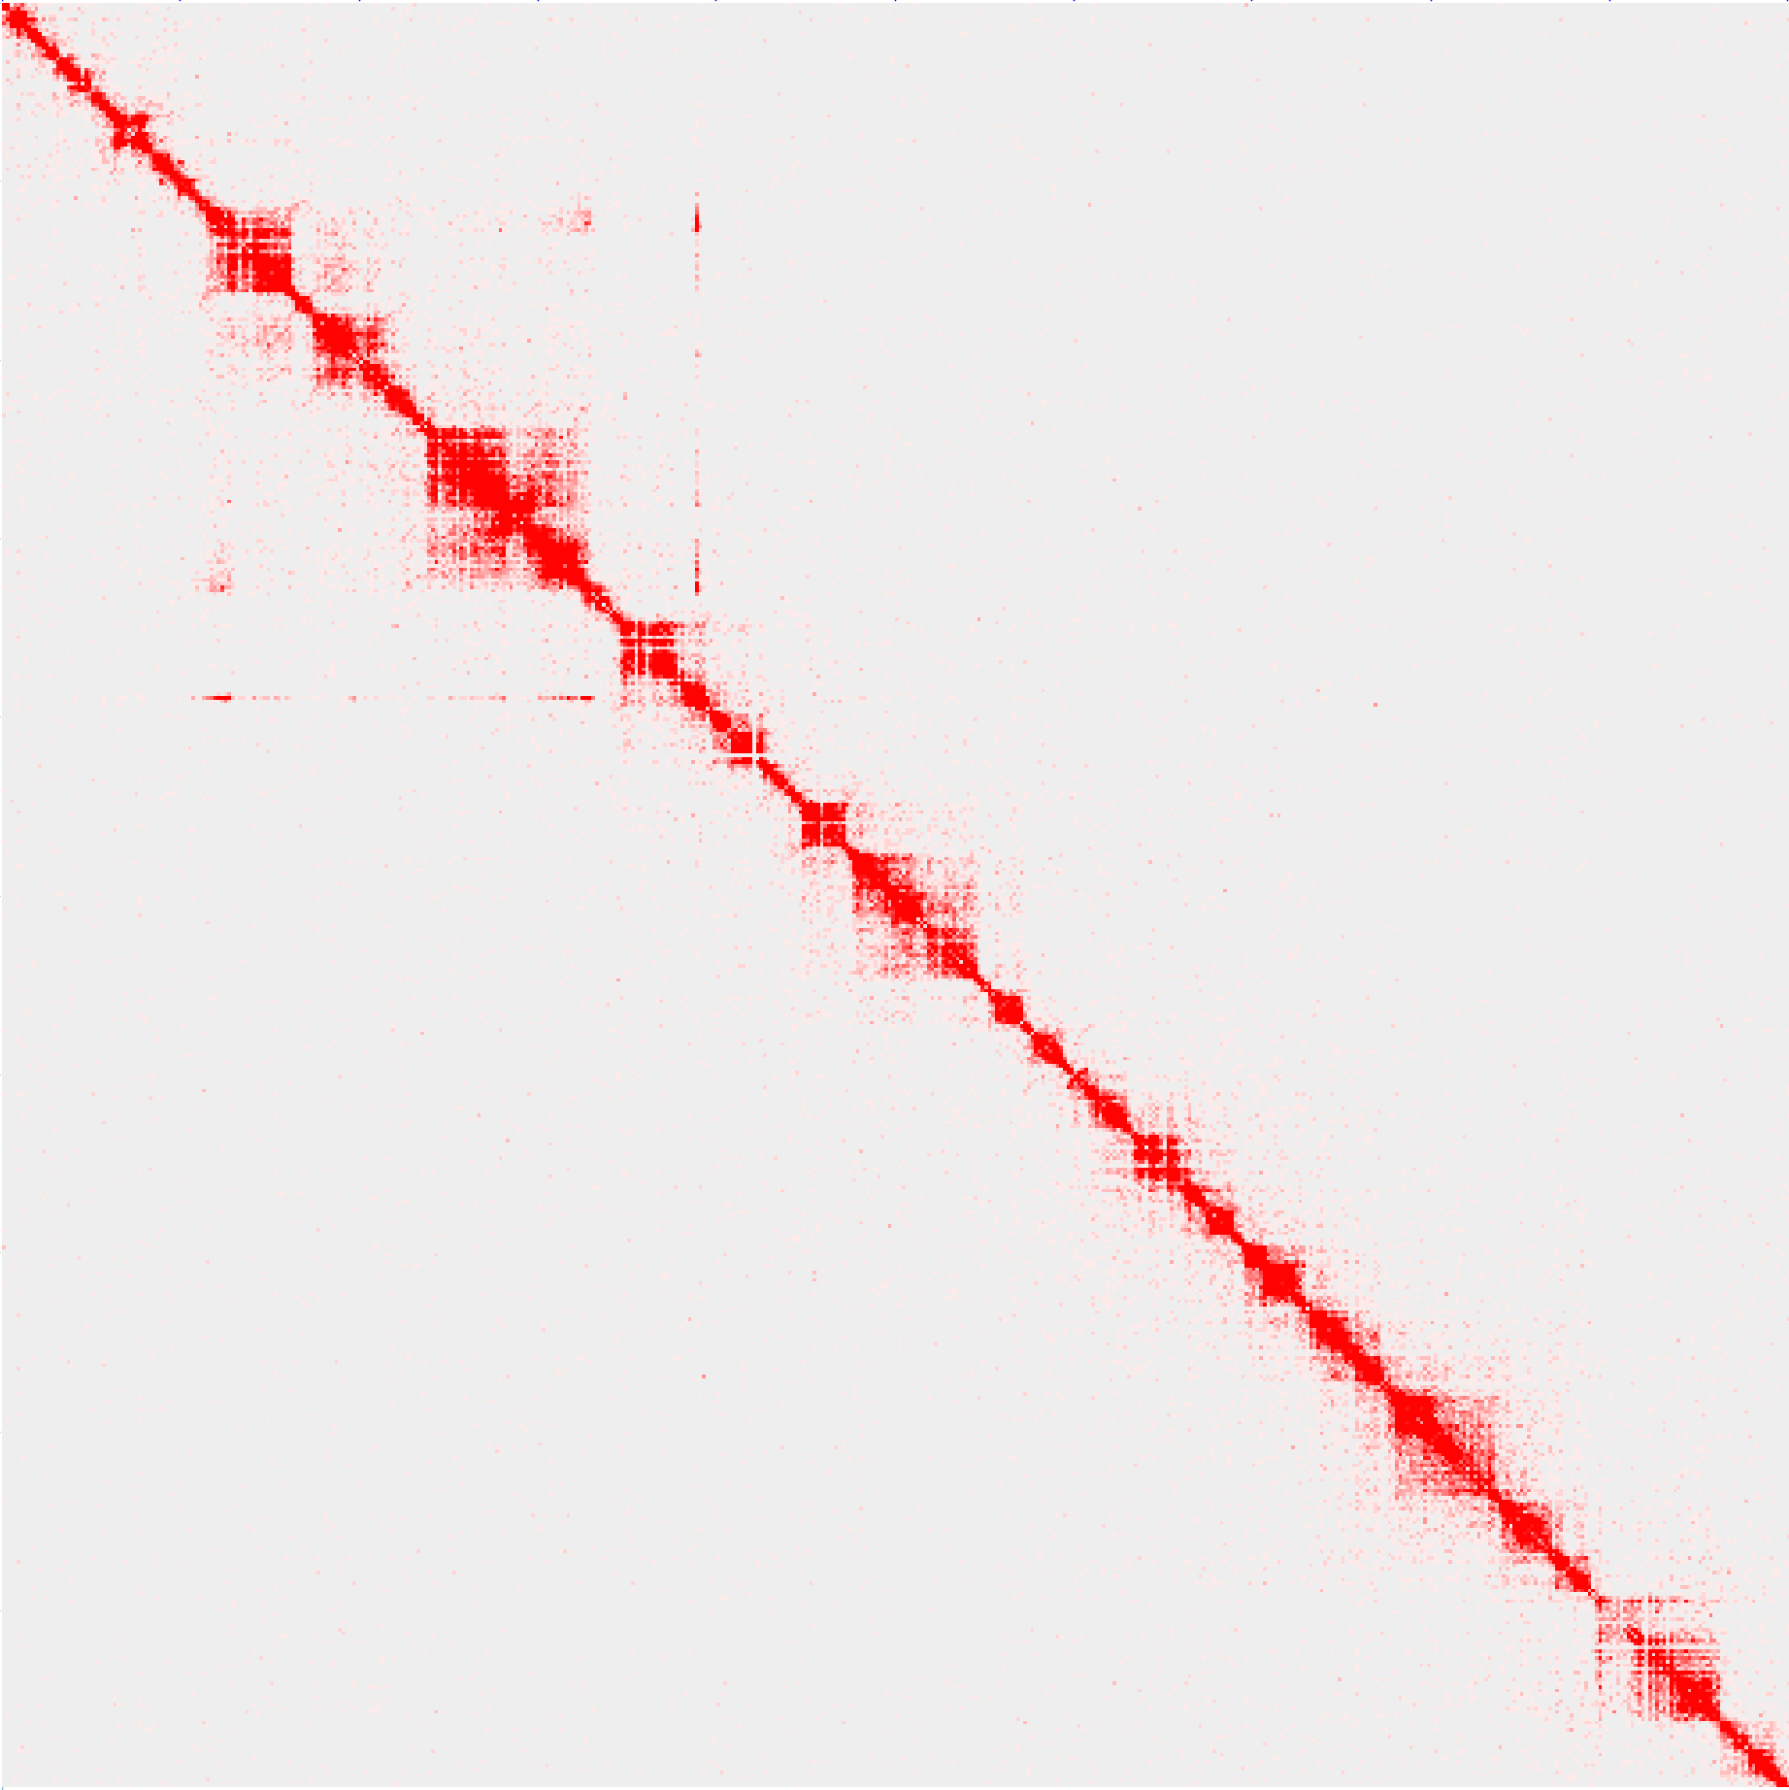
Data quality
Data reproducibility of in situ ChIA-PET (hic matrix)
H3K27me3_WT_rep1 chr2L
H3K27me3_WT_rep2 chr2L
Pearson’s
R = 0.97
100Kb
100Kb
Pearson’s
R = 0.99
Pearson’s
R = 0.95
10 100 1000
10 100 1000
10 100 1000
H3K27me3_WT_rep2
H3K27ac_WT_rep2
RNAPII_WT_rep2
10 100 1000
10 100 1000
10 100 1000
H3K27me3_WT_rep1
H3K27ac_WT_rep1
RNAPII_WT_rep1
chr2L: 0-5 Mb
chr2L: 0-5 Mb
Pearson’s
R = 0.96
10Kb
10Kb
Pearson’s
R = 0.99
Pearson’s
R = 0.91
10 100 1000
10 100 1000
10 100 1000
H3K27me3_HS_rep2
H3K27ac_HS_rep2
RNAPII_HS_rep2
10 100 1000
10 100 1000
10 100 1000
H3K27me3_HS_rep1
H3K27ac_HS_rep1
RNAPII_HS_rep1

Slide 18
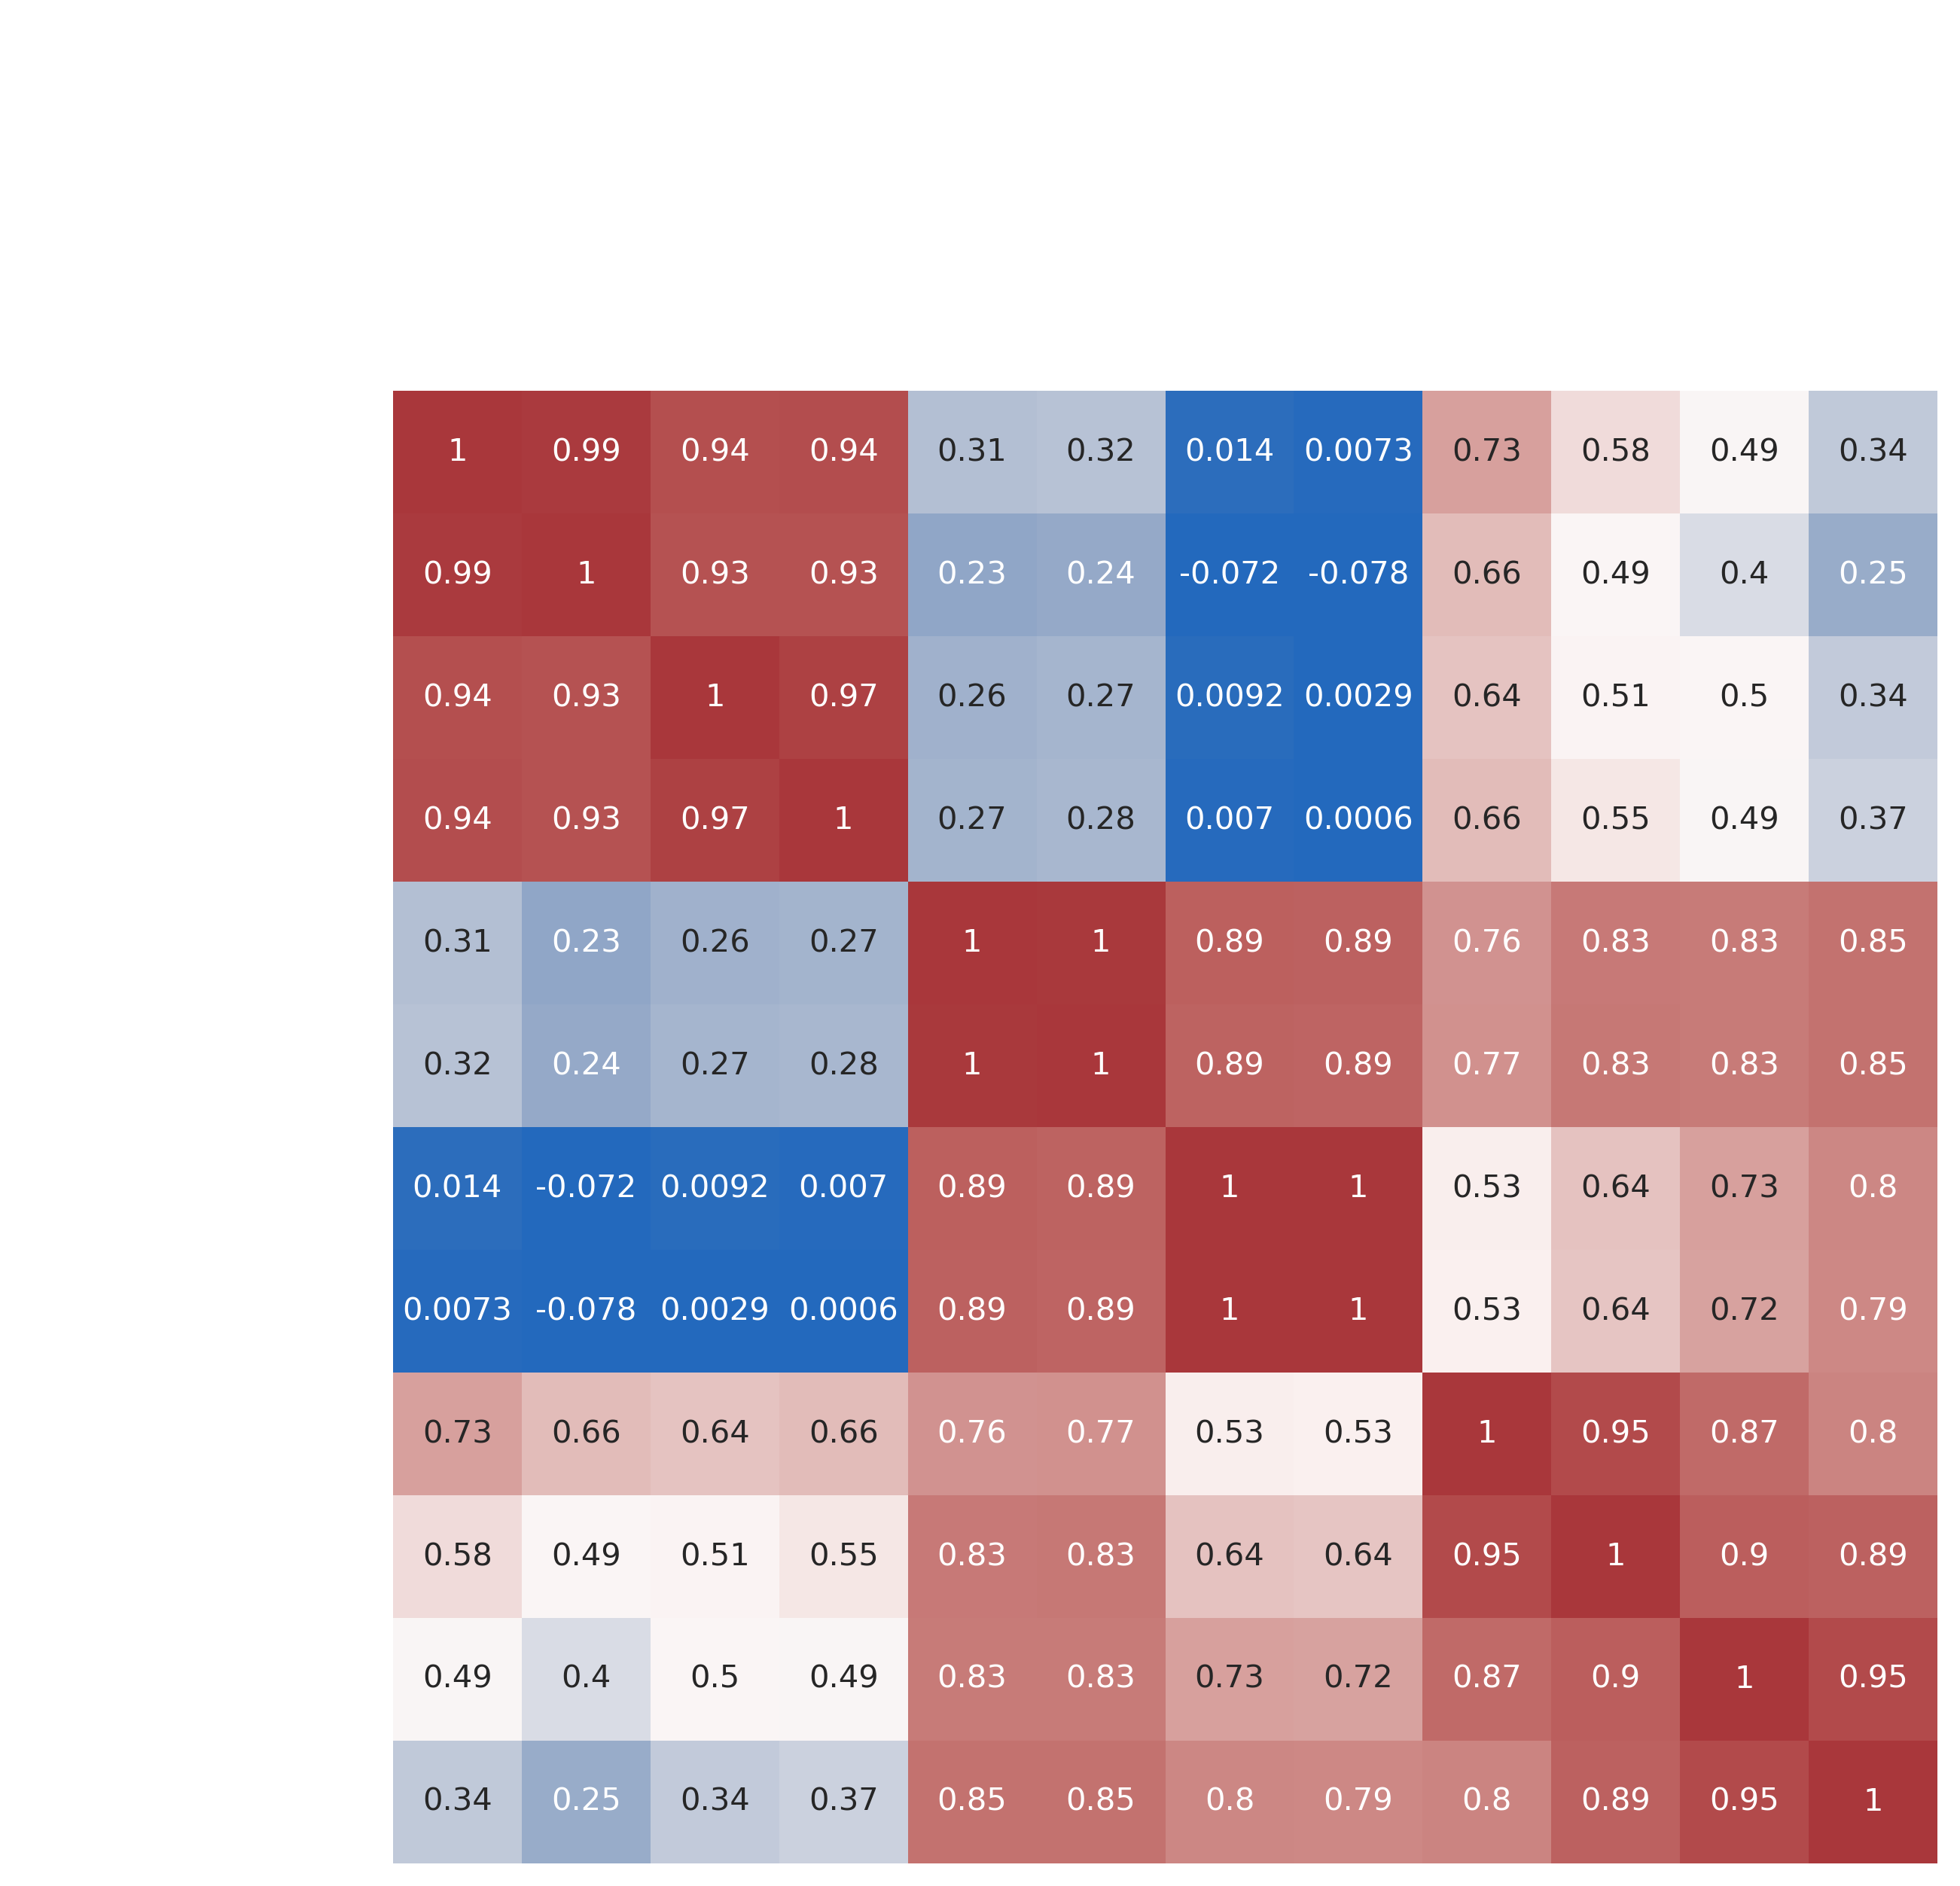
Data quality
Data reproducibility of in situ ChIA-PET (hic matrix)
H3K27ac_WT_rep2
H3K27ac_HS_rep1
H3K27ac_WT_rep1
H3K27ac_HS_rep2
H3K27me3_HS_rep2
H3K27me3_HS_rep1
RNAP II_WT_rep2
RNAP II_HS_rep2
H3K27me3_WT_rep2
RNAP II_HS_rep1
H3K27me3_WT_rep1
RNAP II_WT_rep1
H3K27me3_WT_rep1
H3K27me3_WT_rep2
H3K27me3_HS_rep1
The SCC between the WT and its corresponding HS is smaller than that of two replicates;
The SCC between H3K27ac and RNAPII is larger than that between H3K27me3 and RNAPII.
H3K27me3_HS_rep2
H3K27ac_WT_rep1
H3K27ac_WT_rep2
H3K27ac_HS_rep1
H3K27ac_HS_rep2
RNAP II_WT_rep1
RNAP II_WT_rep2
RNAP II_HS_rep1
RNAP II_HS_rep2
Heatmap of stratum adjusted correlation coefficient (SCC)
(SCC is called using HiCRep.)
Yang et al., Genome Res. 2017

Slide 19
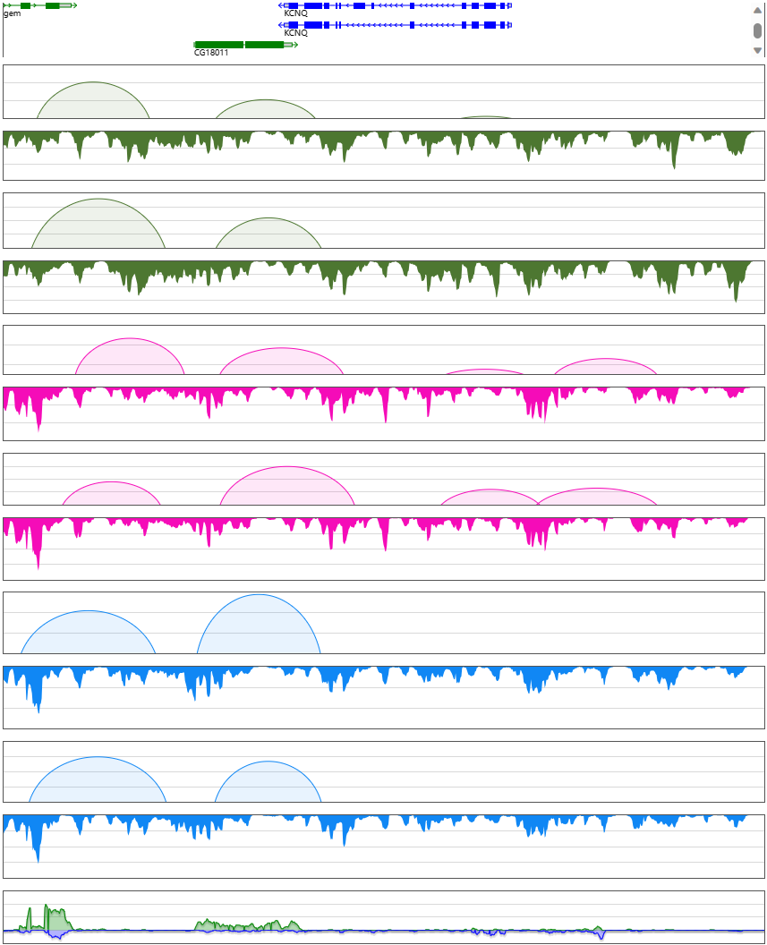
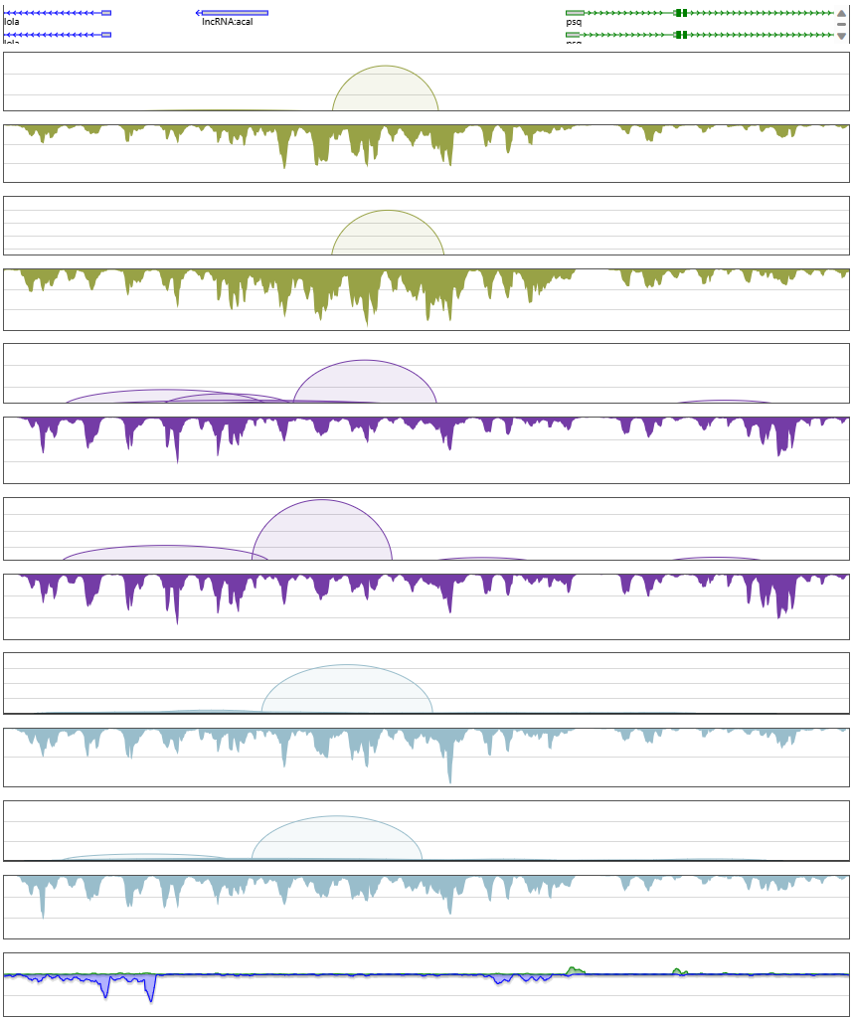
Data quality
Data reproducibility of in situ ChIA-PET (loops and coverage)
chr2R:6022306-6052385 (30Kb)
chr2R:6425378-6455457 (30Kb)
Genes
Genes
loop
loop
rep1
rep1
H3K27me3_WT
coverage
H3K27me3_HS
coverage
loop
loop
rep2
rep2
coverage
coverage
loop
loop
rep1
rep1
coverage
coverage
H3K27ac_WT
loop
H3K27ac_HS
loop
rep2
coverage
rep2
coverage
loop
loop
rep1
rep1
coverage
RNAPII_HS
coverage
RNAPII_WT
loop
loop
rep2
rep2
coverage
coverage
RNA-seq
RNA-seq

Slide 20
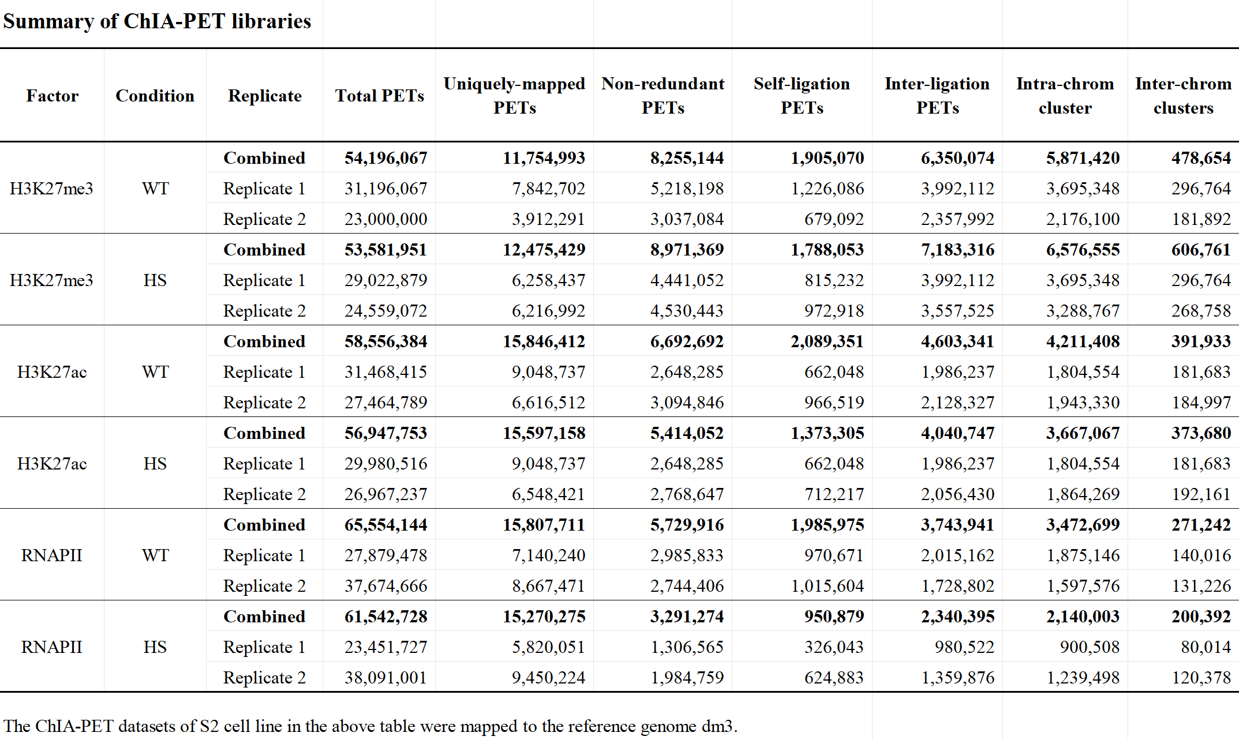
Data quality
Combine two replicates of ChIA-PET libraries for further analysis
WT and its corresponding HS have similar number of uniquely-mapped PETs
in situ ChIA-PET: Duo Ning, Yang Yang
ChIA-PIPE: Deng Yuqing
RNA-seq: Novogen

Slide 21
Data analysis
Describe features before and after heat shock at different scales (Loops, compartments and TADs, )
Explore the relationship between features and gene expression and regulation

Slide 22
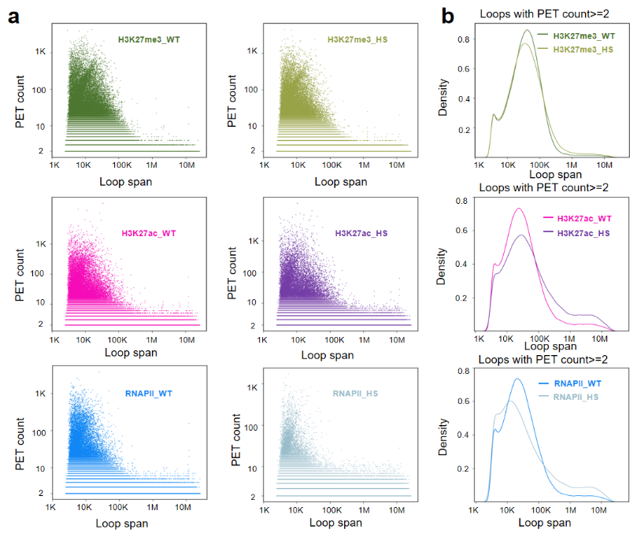
Loop level
Features of chromatin loops enriched by different factors before and after heat shock

Slide 23
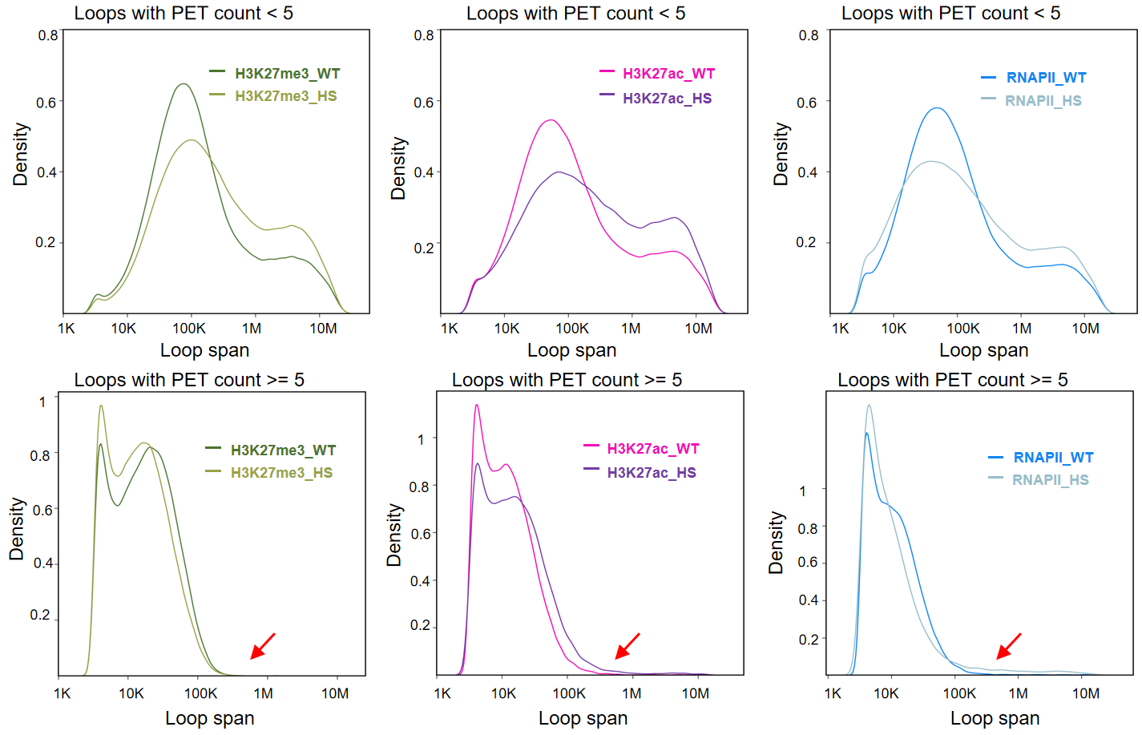
Loop level
Features of chromatin loops enriched by different factors before and after heat shock
After HS, proportion of loops with large loop span increase in H3K27ac_ChIA-PET and RNAP II_ChIA-PET

Slide 24
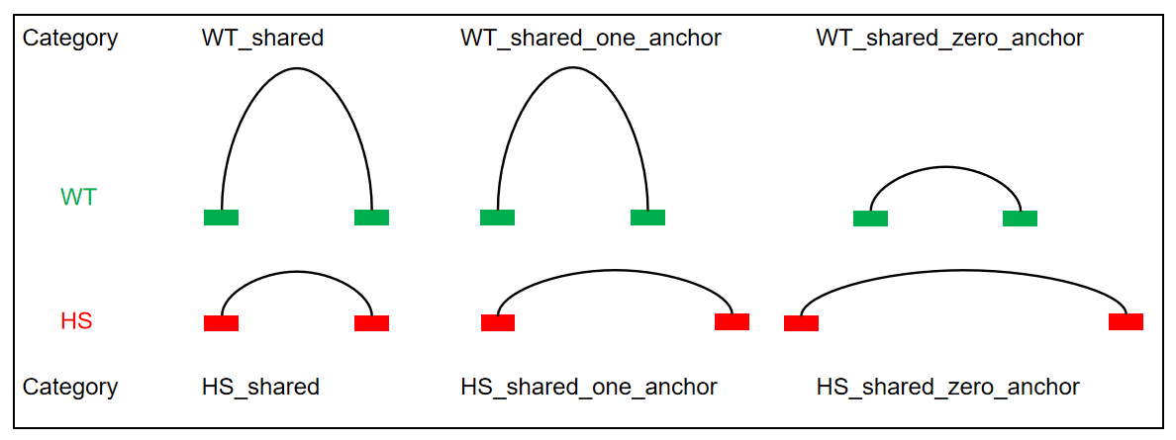
Loop level
Features of chromatin loops enriched by different factors before and after heat shock

Slide 25
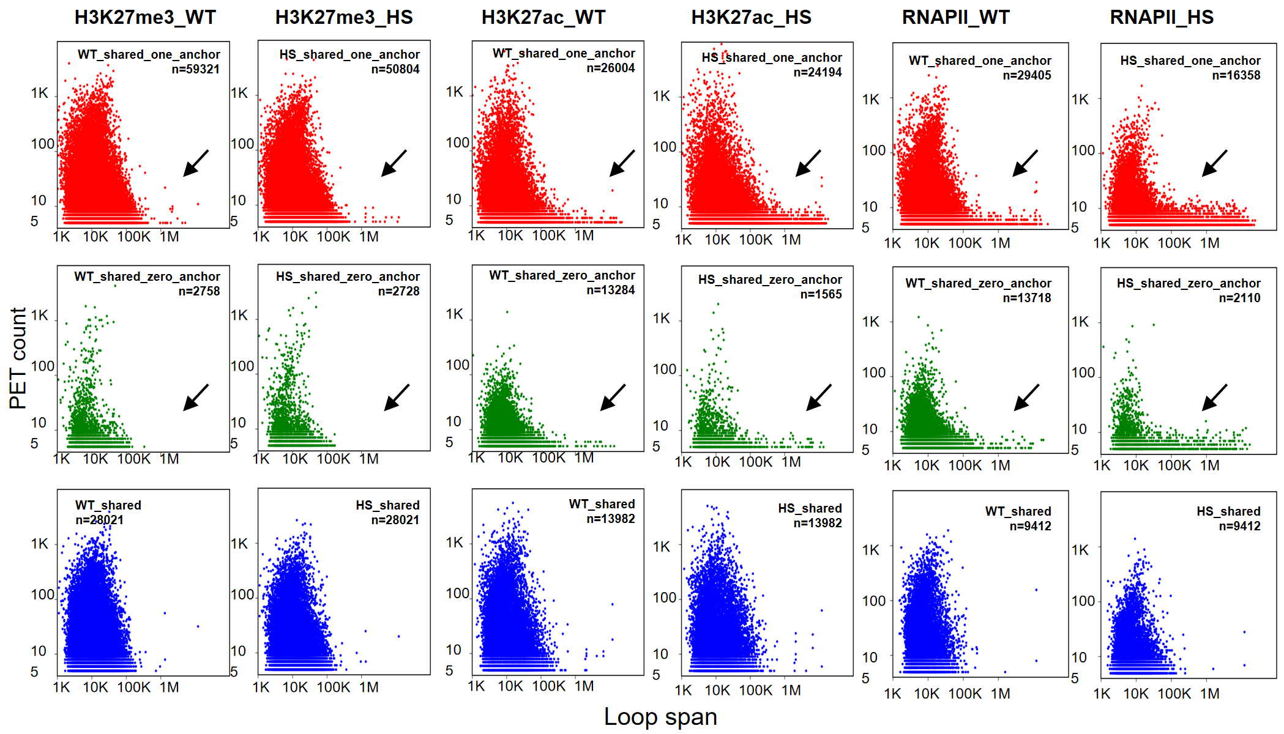
Loop level
Features of chromatin loops enriched by different factors before and after heat shock
After HS, proportion of loops with large loop span and low PET count increase in H3K27ac_ChIA-PET and RNAP II_ChIA-PET

Slide 26
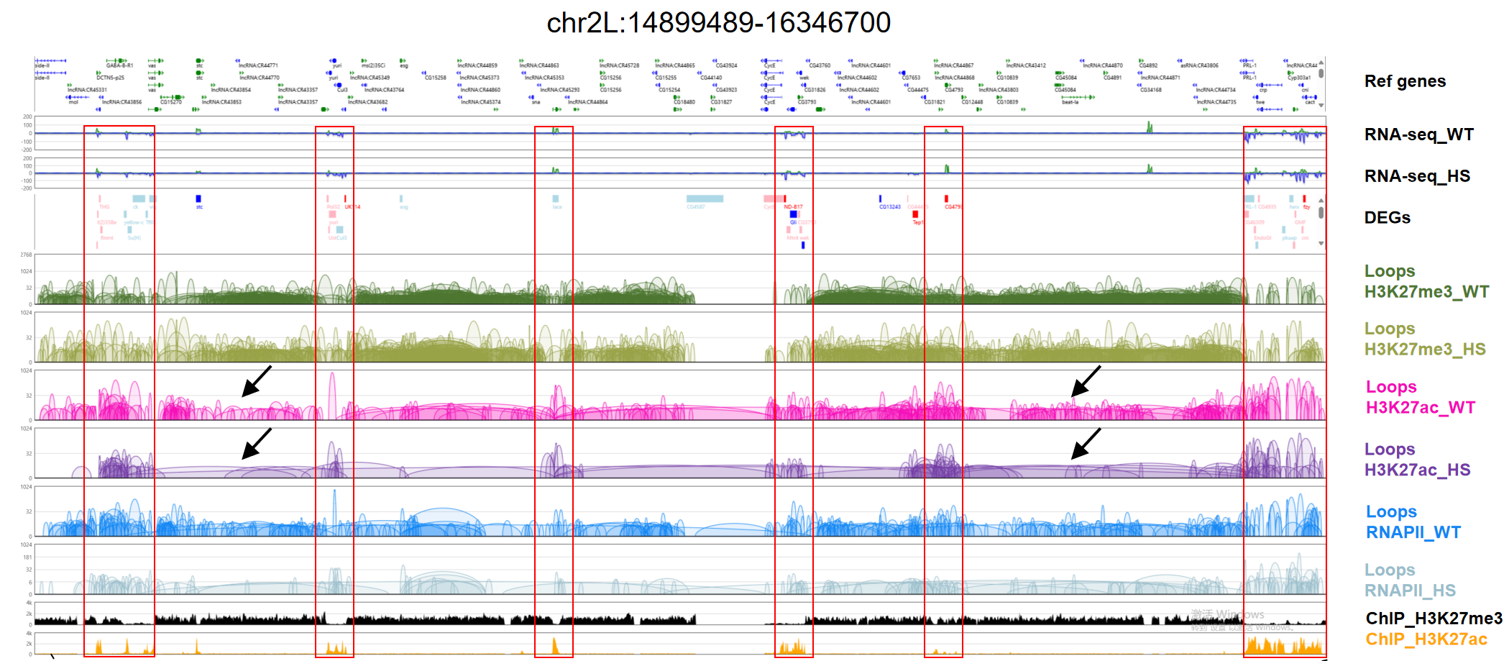
Loop level
Loops induced by heat shock with low PET counts and large loop span connecting different H3K27ac-dominant regions

Slide 27
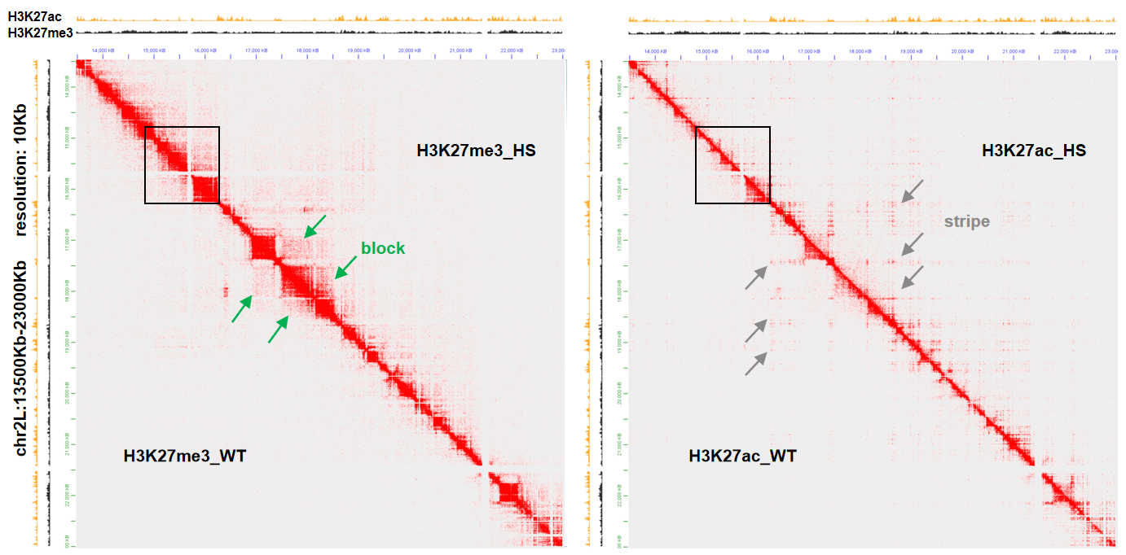
Loop level
Loops induced by heat shock with low PET counts and large loop span connecting different H3K27ac-dominant regions
1. Blocks in H3K27me3_ChIA-PET reflect the interaction between adjacent H3K27me3-dominant regions, while stripes in H3K27ac_ChIA-PET reflect the interaction among multiple H3K27ac-dominant regions
2. After heat shock, blocks in H3K27me3_ChIA-PET and stripes in H3K27ac_ChIA-PET are more obvious.

Slide 28
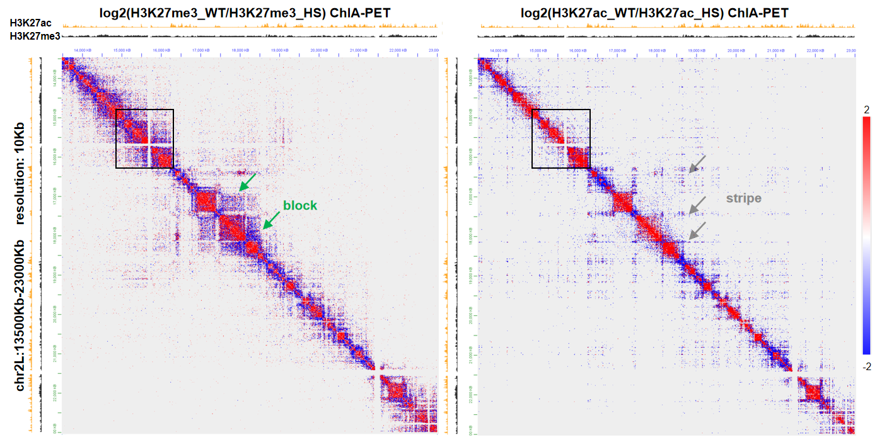
Loop level
Loops induced by heat shock with low PET counts and large loop span connecting different H3K27ac-dominant regions
1. Blocks in H3K27me3_ChIA-PET reflect the interaction between adjacent H3K27me3-dominant regions, while stripes in H3K27ac_ChIA-PET reflect the interaction among multiple H3K27ac-dominant regions
2. After heat shock, blocks in H3K27me3_ChIA-PET and stripes in H3K27ac_ChIA-PET are more obvious.

Slide 29
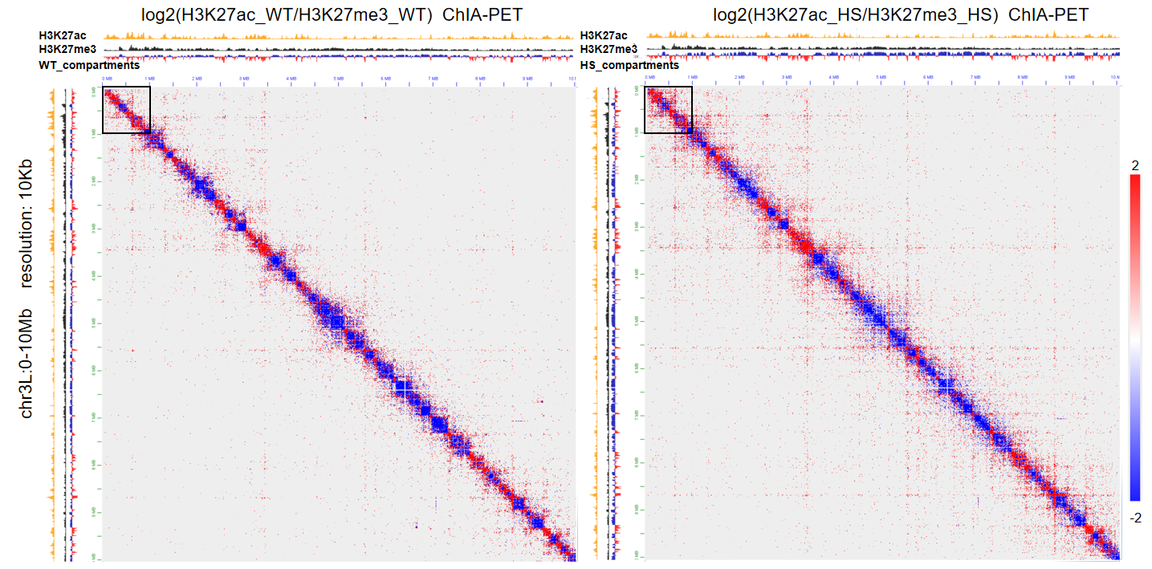
Log2(H3K27ac/H3K27me3) and can be used to call H3K27ac-dominant and H3K27me3-dominant regions
Compartment level
Compartment score = log2(H3K27ac/H3K27me3), if it’s positive, assign the bin as ‘A’, else assign the ‘bin’ as ‘B’.
Its absolute value denotes the extent of compartmentalization

Slide 30
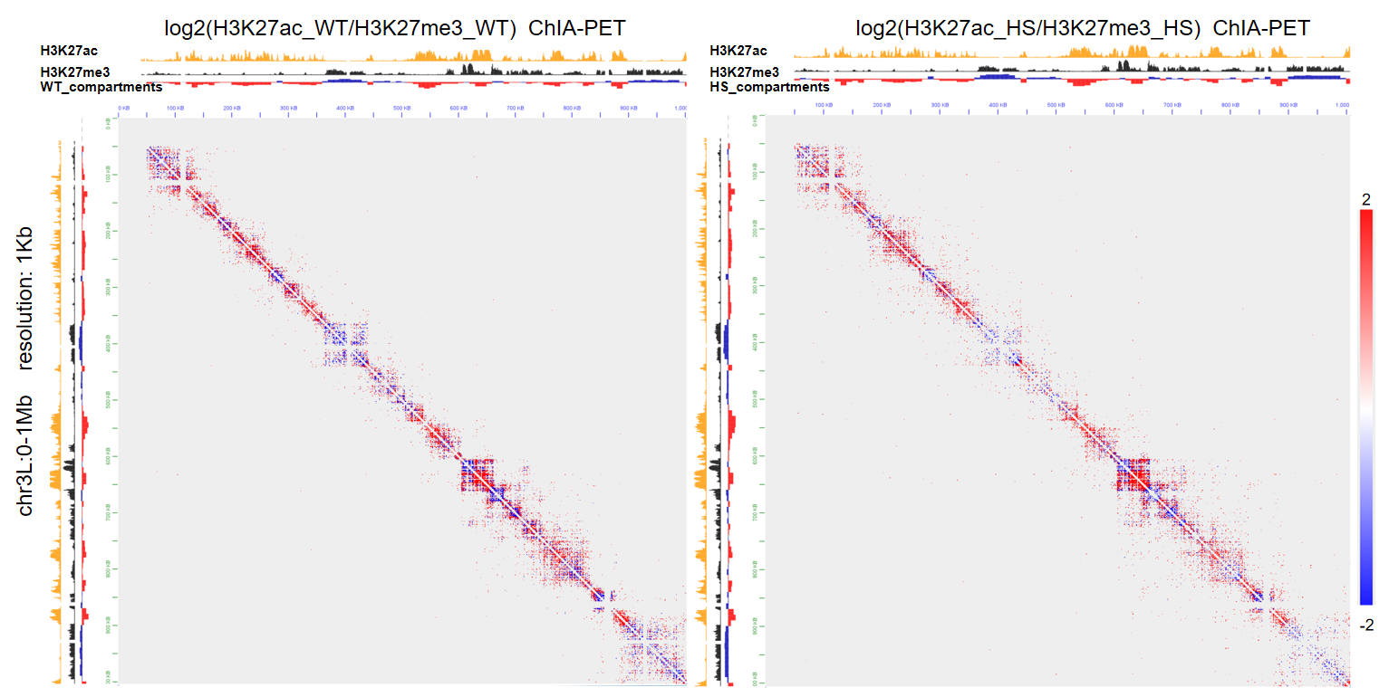
Log2(H3K27ac/H3K27me3) and can be used to call H3K27ac-dominant and H3K27me3-dominant regions
Compartment level
Compartment score = log2(H3K27ac/H3K27me3), if it’s positive, assign the bin as ‘A’, else assign the ‘bin’ as ‘B’.
Its absolute value denotes the extent of compartmentalization

Slide 31
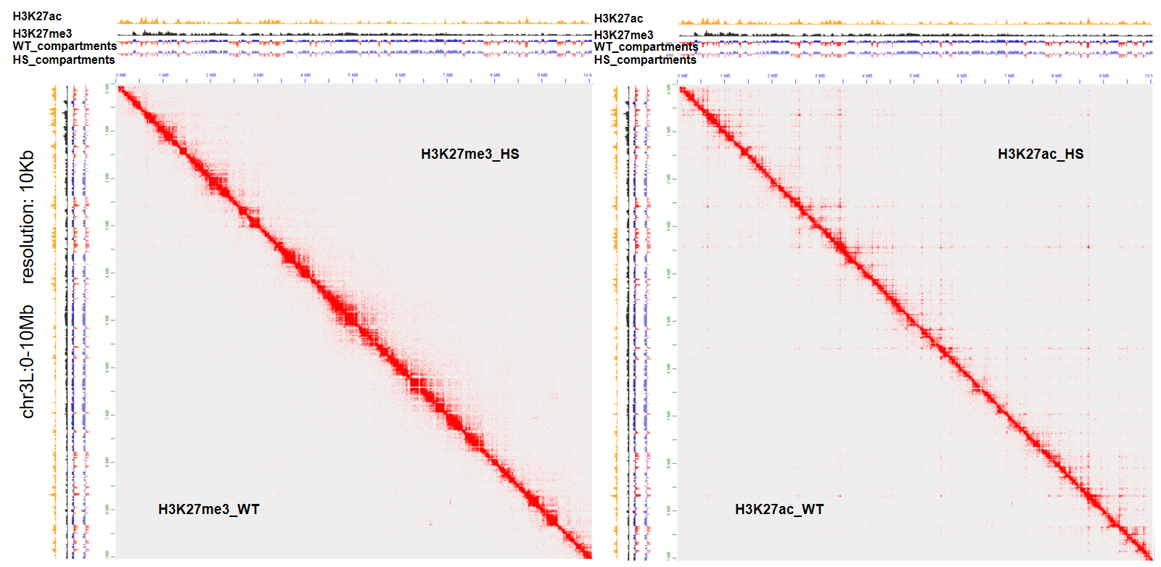
Log2(H3K27ac/H3K27me3) and can be used to call H3K27ac-dominant and H3K27me3-dominant regions
Compartment level
Compartment score = log2(H3K27ac/H3K27me3), if it’s positive, assign the bin as ‘A’, else assign the ‘bin’ as ‘B’.
Its absolute value denotes the extent of compartmentalization

Slide 32
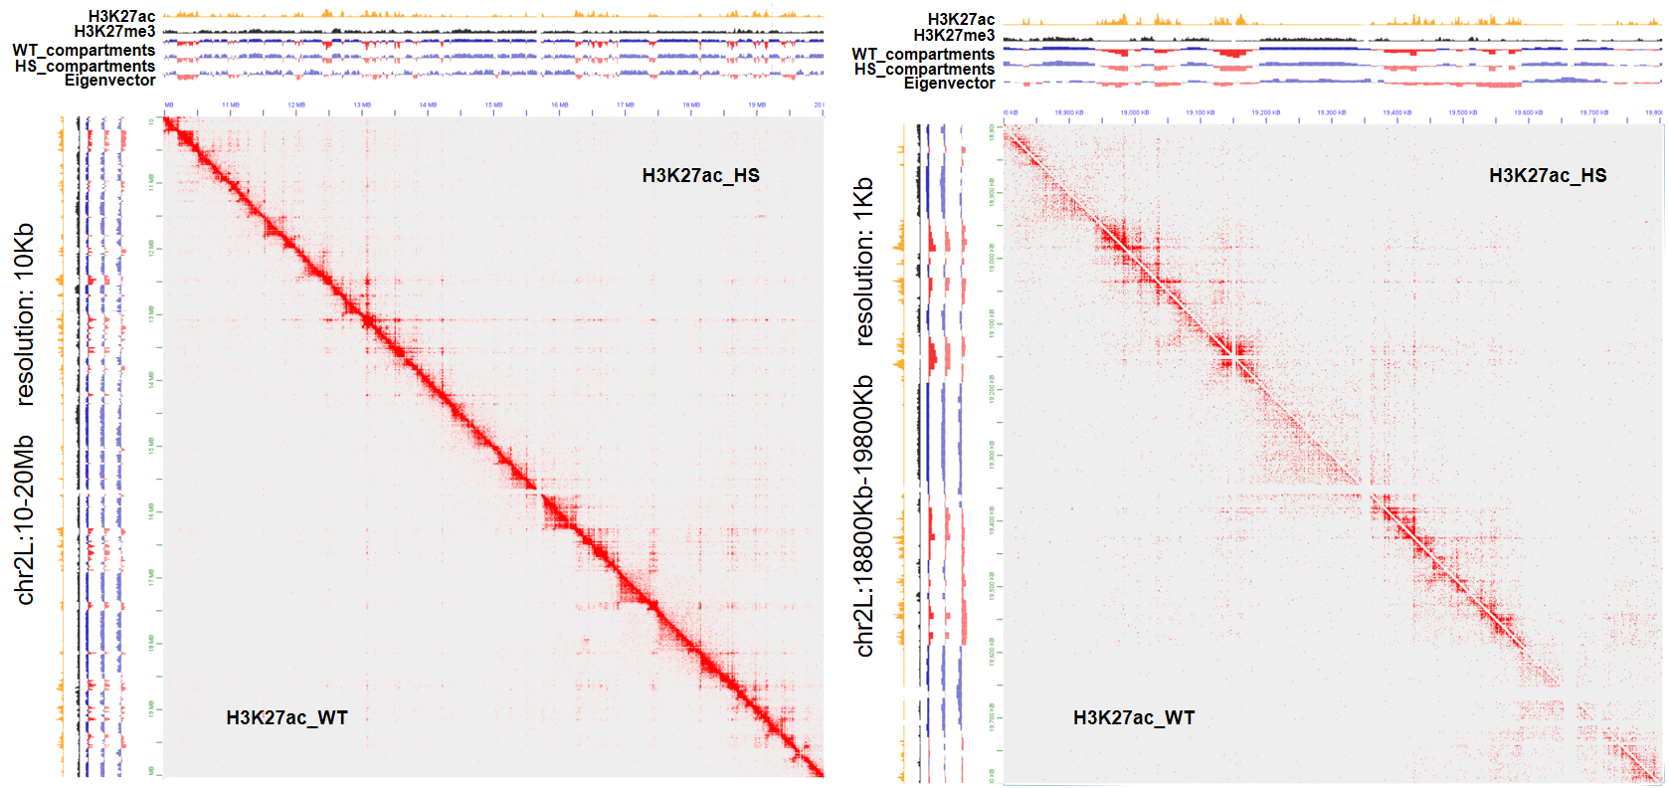
Compartment level
H3K27ac-dominant and H3K27me3-dominant regions align with A and B compartments
Eigenvector are called using Hi-C data of Drosophila in WT condition at 10 Kb resolution (Ray et al., PNAS. 2019)
Eigenvector are called using PCA (Erez et al., Science. 2009)

Slide 33
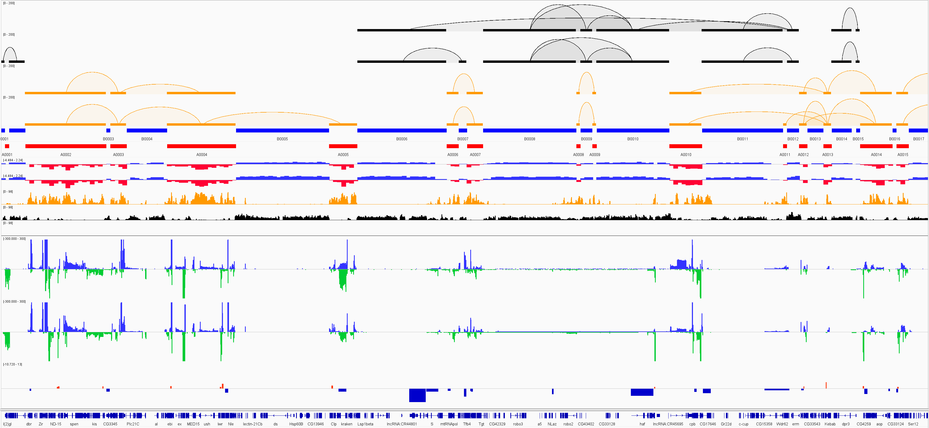
Compartment level
Dynamic A/B compartments
Inter_B interaction
H3K27me3_WT
H3K27me3_HS
Inter_A interaction
H3K27ac_WT
H3K27ac_HS
B compartments
A compartments
WT compartment score
HS compartment score
ChIP_H3K27ac
ChIP_H3K27me3
WT_RNA-seq
HS_RNA-seq
DEGs
Ref genes
For DEGs track, red denotes ‘up-regulated’, while blue denotes ‘dn-regulated’. Its height denotes log2FC

Slide 34
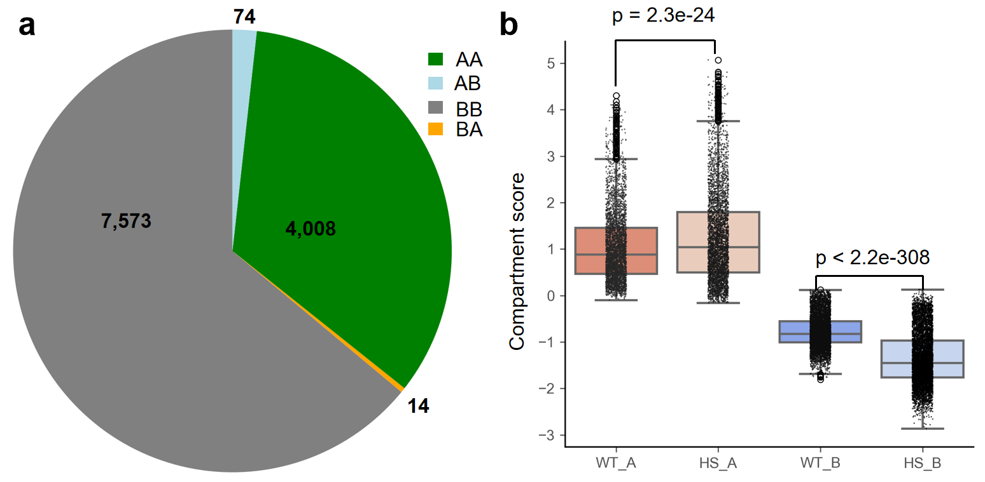
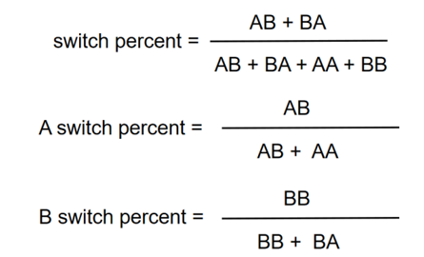
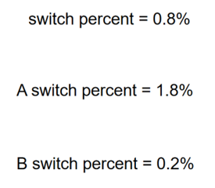
Compartment level
Dynamic A/B compartments
Compartment score = log2(H3K27ac/H3K27me3), if it’s positive, assign the bin as ‘A’, else assign the ‘bin’ as ‘B’. Its absolute value denotes the extent of compartmentalization.
After heat shock, A/B compartment intervals almost do not change, while signals of A/B compartments increase.
Because A/B compartment intervals do not change, it’s convenient to compare them before and after heat shock.

Slide 35
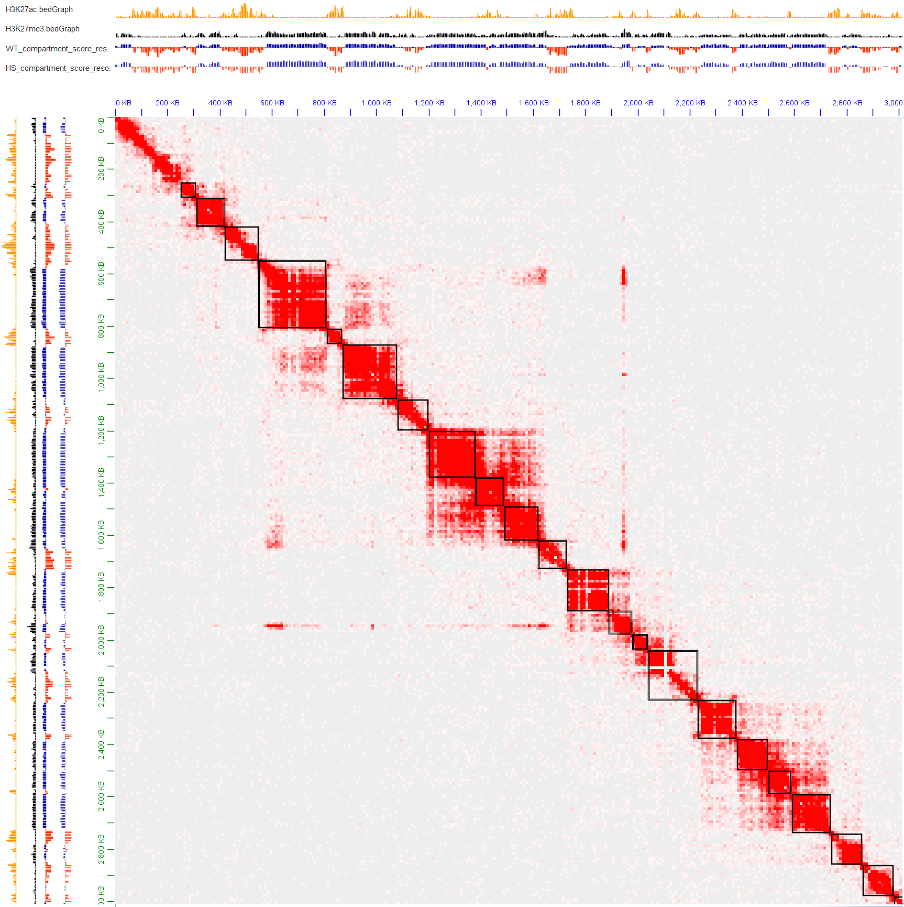
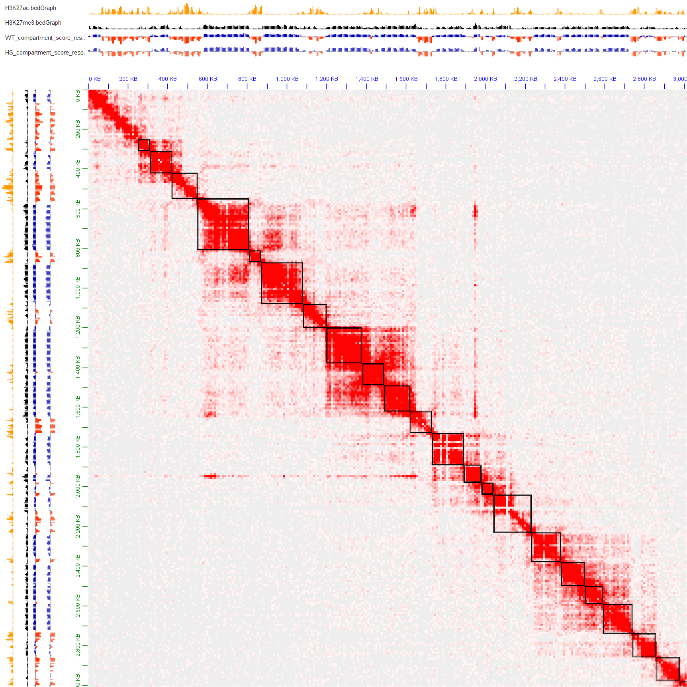
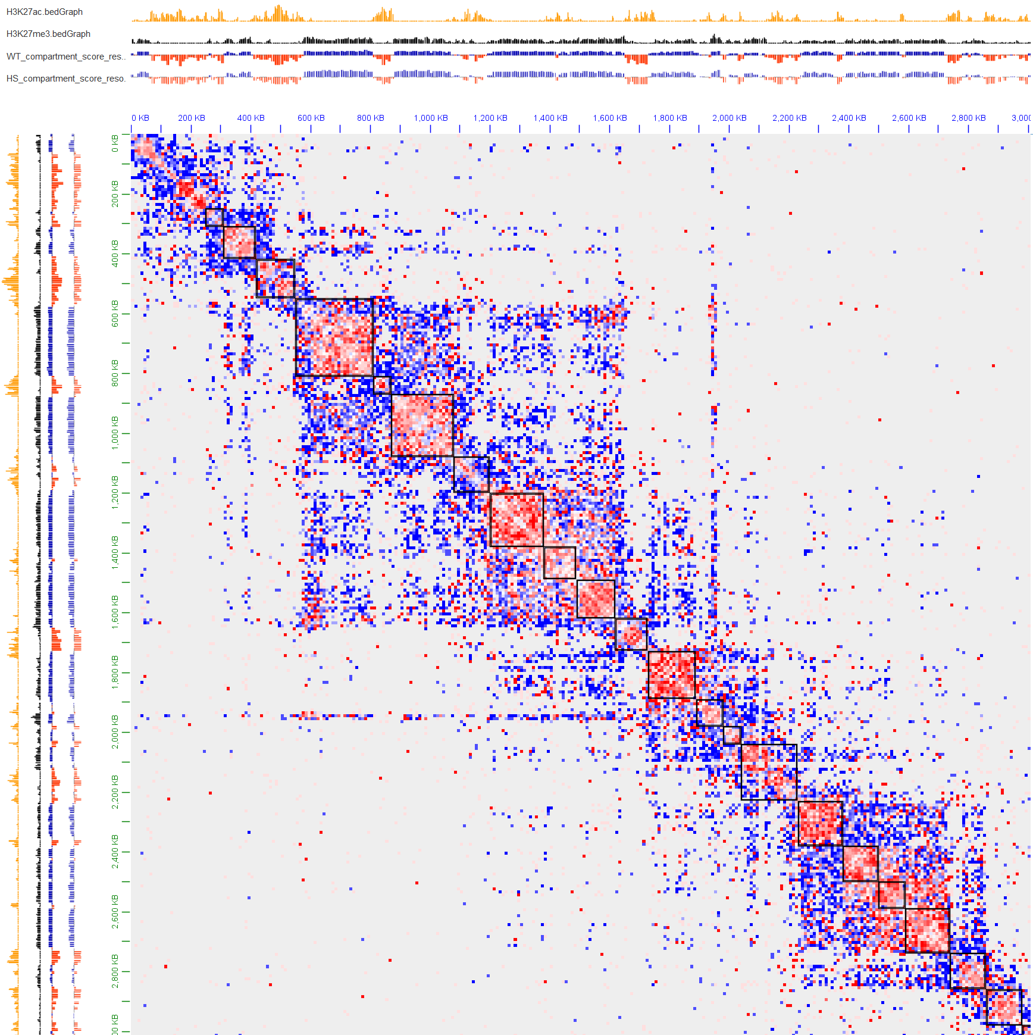
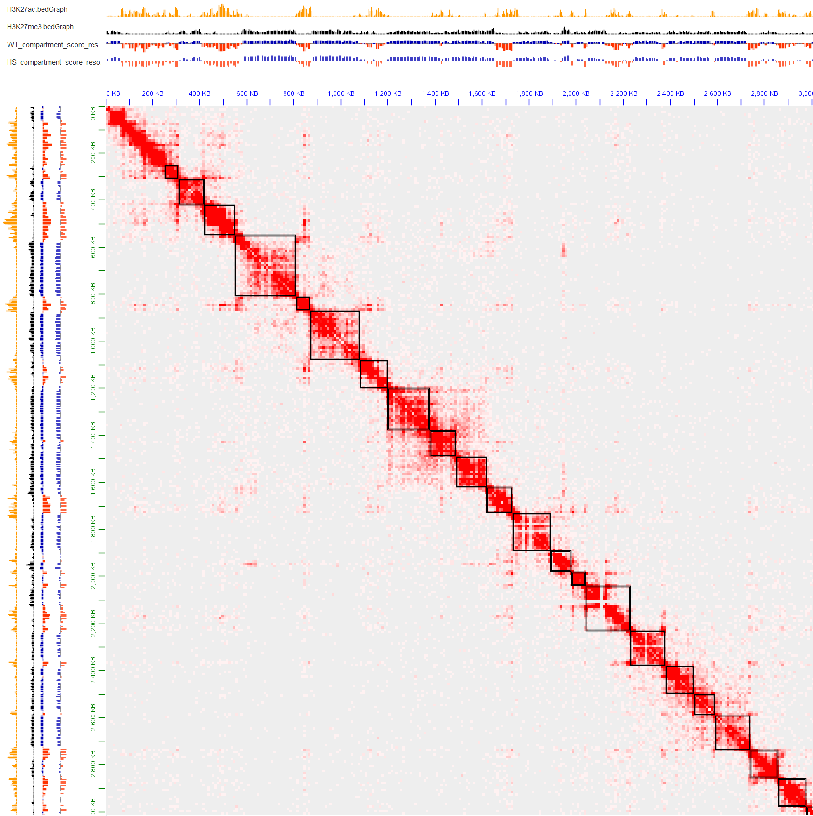
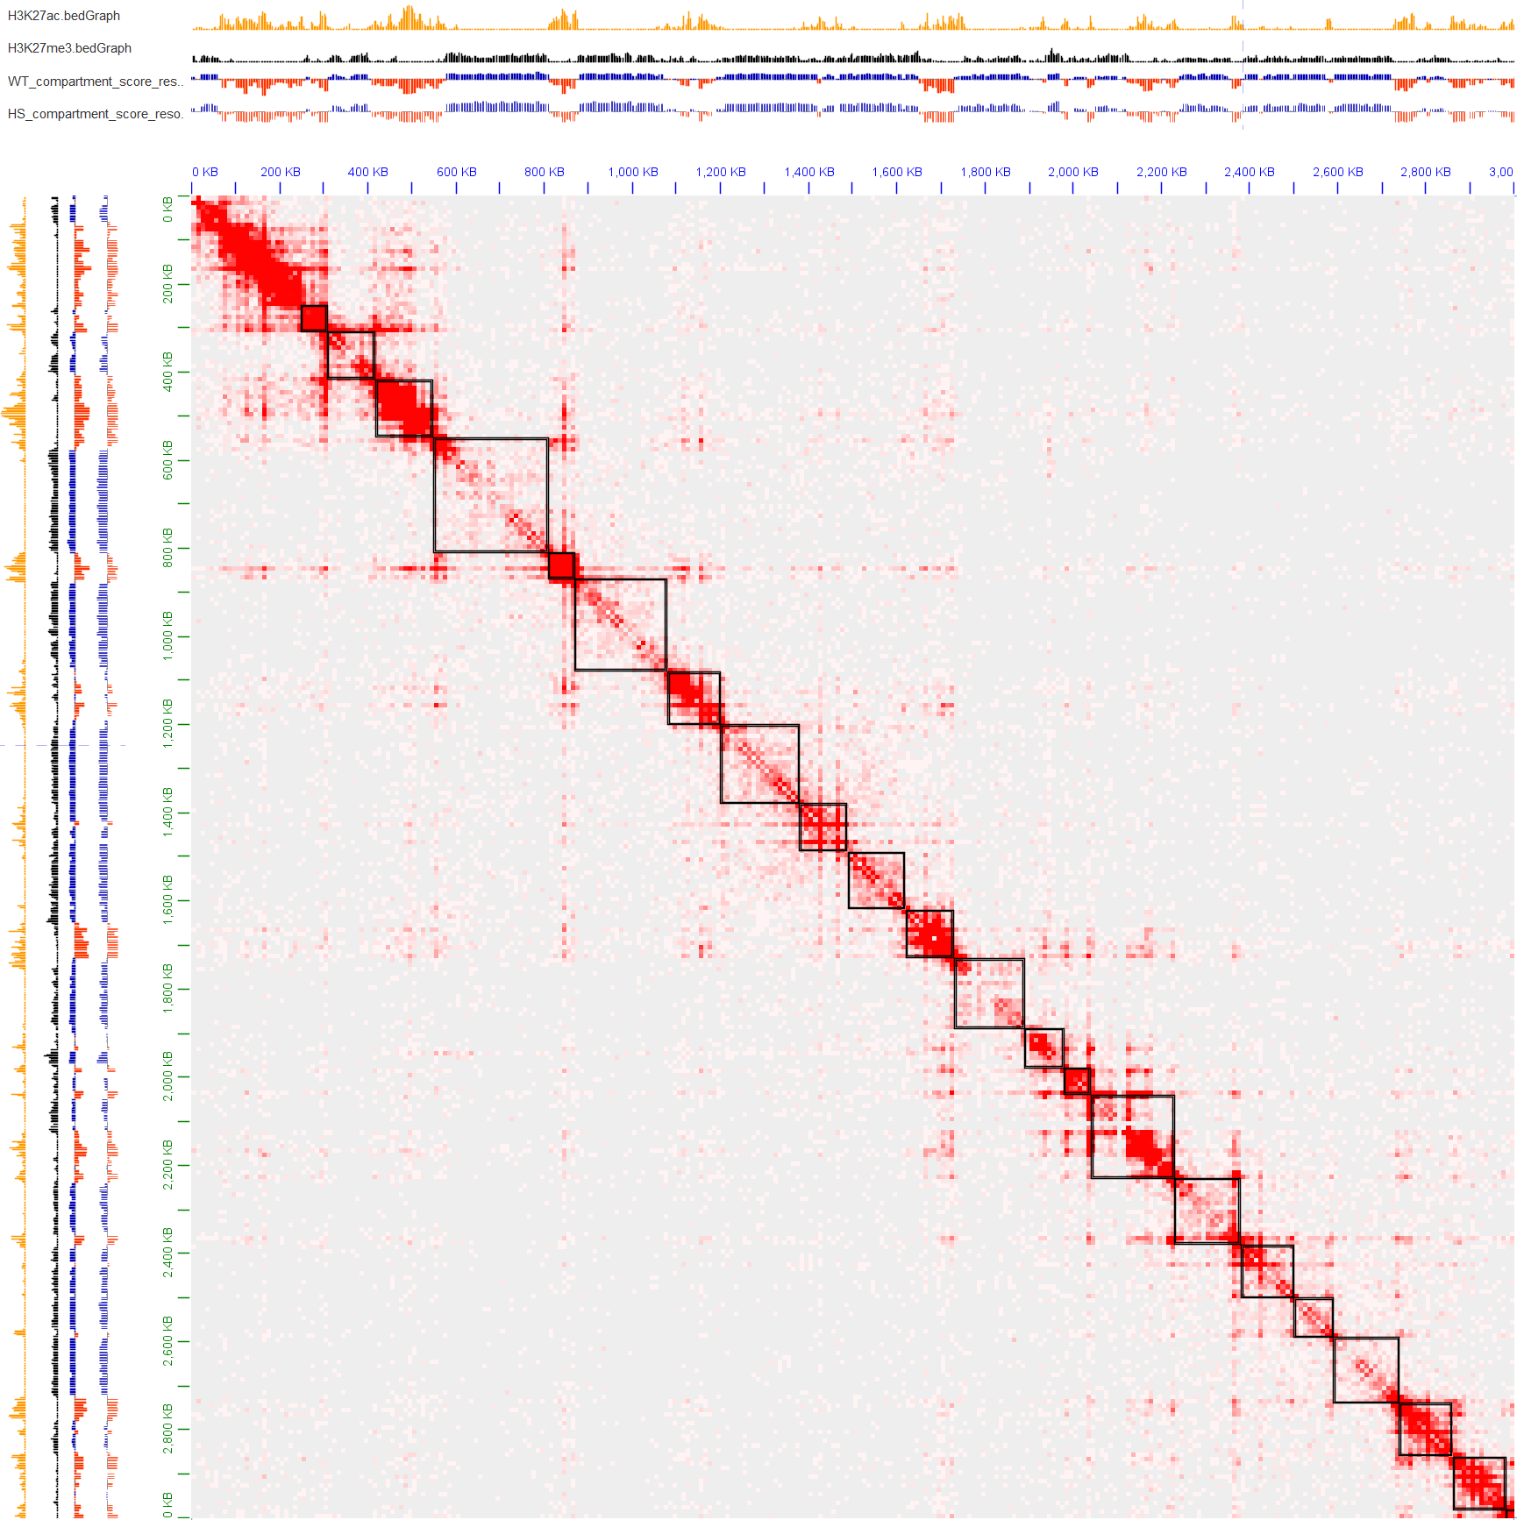
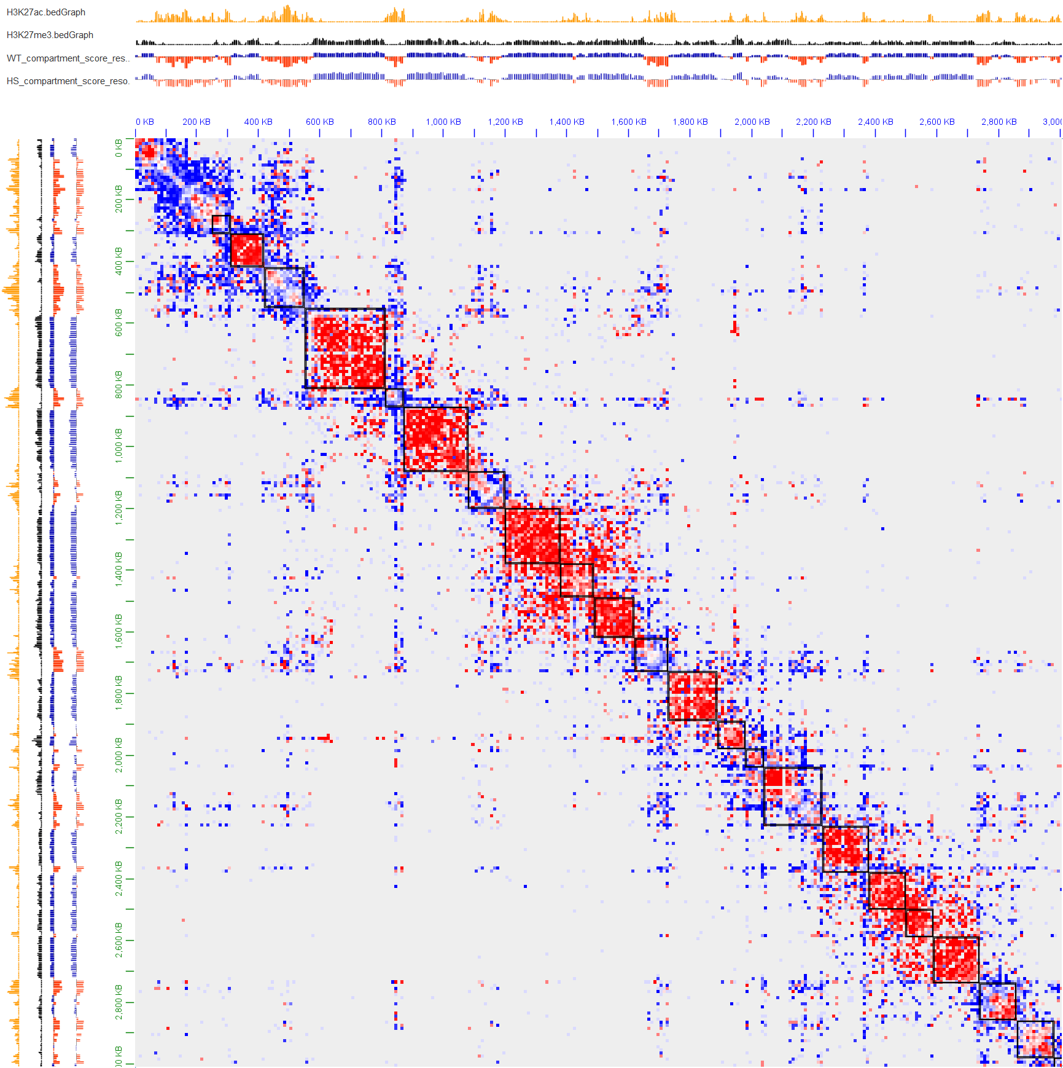
Compartment level
Dynamic A/B compartments
H3K27ac
H3K27me3_WT ChIA-PET
H3K27me3_HS ChIA-PET
H3K27ac
log2(H3K27me3_WT/H3K27me3_HS) ChIA-PET
H3K27me3
H3K27ac
H3K27me3
WT_compartments
H3K27me3
WT_compartments
HS_compartments
WT_compartments
HS_compartments
HS_compartments
4
chr2L:0-3Kb resolution: 10Kb
chr2L:0-3Kb resolution: 10Kb
The black square is the TADs called using hic matrix.
Blue signifies that HS values exceed those of WT, while red represents the converse.
After heat shock, interaction inside A compartments increases, interaction inside B compartments decreases.
Interaction between adjacent B compartments increases, and interaction among multiple A compartments increases.
Goal: quantitatively describe it
chr2L:0-3Kb resolution: 10Kb
-4
H3K27ac
H3K27ac_WT ChIA-PET
H3K27ac_HS ChIA-PET
log2(H3K27ac_WT/H3K27ac_HS) ChIA-PET
H3K27me3
H3K27ac
H3K27ac
WT_compartments
H3K27me3
H3K27me3
HS_compartments
WT_compartments
WT_compartments
HS_compartments
HS_compartments
4
chr2L:0-3Kb resolution: 10Kb
chr2L:0-3Kb resolution: 10Kb
chr2L:0-3Kb resolution: 10Kb
-4

Slide 36


Compartment level
Classify loops into 5 categories using A/B compartments

Slide 37



Compartment level
Dynamic interaction strength inside compartments and gene expression and regulation
ChIA-PET_H3K27me3 （PET count >= 5）
ChIA-PET_RNAPII （PET count >= 5）
ChIA-PET_H3K27ac （PET count >= 5）
After heat shock, interaction strength mediated by RNAPII drops more in B compartments than A compartments.
After heat shock, Pol II occupancy has an overall drop.
Teves et al., Genes & Development. 2011
While interaction (mediated by H3K27me3) strength inside B compartments decreases after heat shock, interaction (mediated by H3K27ac) strength inside A compartments increases.

Slide 38



Compartment level
Dynamic interaction strength inside compartments and gene expression and regulation
ChIA-PET_H3K27me3 （PET count >= 2）
ChIA-PET_RNAPII （PET count >= 2）
ChIA-PET_H3K27ac （PET count >= 2）

Slide 39



Compartment level
Dynamic interaction strength inside compartments and gene expression and regulation
ChIA-PET_H3K27me3 （PET count >= 1）
ChIA-PET_RNAPII （PET count >= 1）
ChIA-PET_H3K27ac （PET count >= 1）

Slide 40



Compartment level
Dynamic interaction strength inside compartments and gene expression and regulation
c
p = 1.4e-5
a
1,142
b
p = 3.0e-5
1,010
unexpressed
B
unregulated
A
up-regulated
dn-regulated
8,440
5,745
log10(FPKM)
unexpressed
unregulated
dn-regulated
up-regulated
 | A | B | Row Totals
up-regulated | 808 | 202 | 1010
dn-regulated | 794 | 346 | 1140
Column Totals | 1602 | 548 | 2150(Grand Total)
1. Genes located in A compartments have higher expression level than those located in B compartments
2. Down-regulated DEGs are more likely to locate in B compartments (chi-square test, p = 5.12e-08). Its consistent with the fact that interaction strength mediated by RNAPII drops more in B compartments than A compartments after heat shock.

Slide 41



Compartment level
Dynamic interaction strength between compartments and gene expression and regulation
The data format is almost the same as that of ChIA-PET loops, except that the anchor is a compartment.
ChIA-PET_H3K27me3
(all inter_B loops with PET count >= 5 )
ChIA-PET_H3K27ac
(all inter_A loops with PET count >= 5 )

Slide 42






Compartment level
Dynamic interaction strength between compartments and gene expression and regulation
There are 12 B compartments on chr4
There are 14 A compartments on chr4

Slide 43




Compartment level
Dynamic interaction strength between compartments and gene expression and regulation
There are 181 B compartments on chr2L
After heat shock, both inter_B interaction and inter_A interaction increase, which is consistent with the fact that signals of A/B compartment increase.
Besides, we can realize that, while inter_B interaction usually increases between two adjacent B compartments, inter_A interaction increases among multiple A compartments.
There are 210 A compartments on chr2L

Slide 44
Compartment level
Dynamic compartment network and gene expression and regulation
Inter_B interaction
H3K27me3_WT
H3K27me3_HS
Inter_A interaction
H3K27ac_WT
H3K27ac_HS
B compartments
A compartments
WT compartment score
HS compartment score
ChIP_H3K27ac
ChIP_H3K27me3
WT_RNA-seq
HS_RNA-seq
DEGs
Ref genes

Slide 45




Compartment level
Dynamic compartment network and gene expression and regulation
a
c
I want to use Cytoscape to display the A compartment network before and after heat shock. For A compartment network, the higher the domain PET count is, the closer spatial distance two A compartments have.
(need to be done)
b
After heat shock, while adjacent B compartments have stronger interaction, A compartments in hubs become even closer or form new larger hubs. So, we can construct a network of A compartments before and after heat shock, and we can also explore the dynamic network and its relationship with gene expression and regulation.

Slide 46
Compartment level
Dynamic compartment network and gene expression and regulation
Is the change of the compartment netwrok related to gene expression and regulation ?
Its relationship with gene expression and regulation is still under exploration

Slide 47






TAD level
Sum of H3K27me3_ChIA-PET and H3K27ac_ChIA-PET
H3K27ac
H3K27me3_WT ChIA-PET
H3K27ac
H3K27ac_WT ChIA-PET
H3K27ac
H3K27me3_WT+H3K27ac_WT ChIA-PET
H3K27me3
H3K27me3
H3K27me3
WT_compartments
WT_compartments
WT_compartments
HS_compartments
HS_compartments
HS_compartments
chr2L:0-5Mb resolution: 10Kb
chr2L:0-5Mb resolution: 10Kb
chr2L:0-5Mb resolution: 10Kb
H3K27me3_HS ChIA-PET
H3K27ac_HS ChIA-PET
H3K27ac_HS/H3K27ac_HS ChIA-PET
H3K27ac
H3K27ac
H3K27ac
H3K27me3
H3K27me3
H3K27me3
WT_compartments
WT_compartments
WT_compartments
HS_compartments
HS_compartments
HS_compartments
chr2L:0-5Mb resolution: 10Kb
chr2L:0-5Mb resolution: 10Kb
chr2L:0-5Mb resolution: 10Kb

Slide 48






TAD level
Sum of H3K27me3_ChIA-PET and H3K27ac_ChIA-PET
H3K27me3_WT ChIA-PET
H3K27ac_WT ChIA-PET
H3K27me3_WT+H3K27ac_WT ChIA-PET
H3K27ac
H3K27ac
H3K27ac
H3K27me3
H3K27me3
H3K27me3
WT_compartments
WT_compartments
WT_compartments
HS_compartments
HS_compartments
HS_compartments
chr2L:0-3Mb resolution: 50Kb
chr2L:0-3Mb resolution: 50Kb
chr2L:0-3Mb resolution: 50Kb
H3K27me3_HS ChIA-PET
H3K27ac_HS ChIA-PET
H3K27ac_HS+H3K27ac_HS ChIA-PET
H3K27ac
H3K27ac
H3K27ac
H3K27me3
H3K27me3
H3K27me3
WT_compartments
WT_compartments
WT_compartments
HS_compartments
HS_compartments
HS_compartments
chr2L:0-23Mb resolution: 50Kb
chr2L:0-23Mb resolution: 50Kb
chr2L:0-23Mb resolution: 50Kb

Slide 49




TAD level
Sum of H3K27me3_ChIA-PET and H3K27ac_ChIA-PET is approximate to Hi-C
Hi-C_WT
H3K27me3_WT+H3K27ac_WT ChIA-PET
H3K27ac
H3K27ac
H3K27me3
H3K27me3
H3K27me3_ChIA-PET and H3K27ac_ChIA-PET is approximate to Hi-C in Drosophila.
chr2L:0-23Mb resolution: 50Kb
chr2L:0-23Mb resolution: 50Kb
Nichols et al., Cell Reports. 2021
ChIA-PET is approximate to Hi-C plus the enrichment of some factor
(H3K27me3_WT+H3K27ac_WT) ChIA-PET and (H3K27me3_HS+H3K27ac_HS) ChIA-PET can be used to study the dynamic TADs induced by heat shock.
RNAPII_WT ChIA-PET and RNAPII_HS ChIA-PET can be used to study dynamic RNAPII and TAD boundaries under heat shock.
Hi-C_HS
H3K27ac_HS+H3K27ac_HS ChIA-PET
H3K27ac
H3K27ac
H3K27me3
H3K27me3
chr2L:0-23Mb resolution: 50Kb
chr2L:0-23Mb resolution: 50Kb
Hi-C data comes from Ray et al., PNAS. 2019

Slide 50




TAD level
TAD enriched by (H3K27me3+ H3K27ac) before and after HS
A
Chr2L: 0-10Mb
H3K27me3+H3K27ac_HS
H3K27me3+H3K27ac_WT
TAD score
B
Chr2L: 0.3-3Mb
The local minimal of TAD score (TAD separation score) increases after heat shock, indicating that the TAD boundaries weaken after heat shock.
H3K27me3+H3K27ac_HS
H3K27me3+H3K27ac_WT
TADs at 10Kb resolution is called by hicexplorer
Ramirez et al., Nature Communications. 2018
TAD score
H3K27me3+H3K27ac_WT
H3K27me3+H3K27ac_HS

Slide 51




TAD level
Dynamic TADs under heat shock
Scatter plot of TAD score
Scatter plot of TAD score
Spearman’s R = 0.91
K-S pvalue = 7.3e-32
1.2
Spearman’s R = 0.86
K-S pvalue = 6.3e-81
Spearman’s
R = 0.85
0.8
1.2
H3K27me3+H3K27ac_HS (all chroms)
RNAPII_WT (all chroms)
-1 0 1 2 3
-1 0 1 2 3
0.8
0.4
0.4
TAD boundaries are weaker after heat shock (Mann-Whitney U test).
-1 0 1 2 3
-1 0 1 2 3
H3K27me3+H3K27ac_HS (all chroms)
RNAPII_HS (all chroms)
p=1e-3
p=3.8e-12
TAD score
TAD score
-1.5 -1 -0.5 0 0.5
-1.5 -1 -0.5 0 0.5
WT HS
WT HS
H3K27me3+H3K27ac (all chroms)
RNAPII (all chroms)

Slide 52




TAD level
Dynamic TADs under heat shock
Number
Number
H3K27me3+H3K27ac_WT (n=945)
100 200 300 400
RNAPII_WT (n=884)
H3K27me3+H3K27ac_HS (n=954)
RNAPII_HS (n=757)
After heat shock, TAD number and TAD size in H3K27me3+H3K27ac ChIA-PET almost keep, while TAD number reduces and TAD size increases in RNAPII
100 200 300 400 500 600 700 800 900
TAD size (Kb)
TAD size (Kb)
100 Kb
100 Kb
H3K27me3+H3K27ac_WT
RNAPII_WT
H3K27me3+H3K27ac_HS
RNAPII_HS
Scaled density
Scaled density
0.0 0.2 0.4 0.6 0.8 1.0
0.0 0.2 0.4 0.6 0.8 1.0
200 600 1000
200 600 1000
TAD size (Kb)
TAD size (Kb)

Slide 53



TAD level
Dynamic TADs under heat shock
10⁻²
10⁻²
10⁻²
H3K27me3_WT
H3K27me3_WT
H3K27me3_WT
H3K27me3_HS
H3K27me3_HS
H3K27me3_HS
60 Kb
H3K27ac_WT
H3K27ac_WT
10⁻³
10⁻³
60 Kb
H3K27ac_HS
10⁻³
60 Kb
H3K27ac_HS
RNAPII_WT
RNAPII_HS
10⁻⁴
10⁻⁴
10⁻⁴
Corrected Hi-C counts
Corrected Hi-C counts
Corrected Hi-C counts
3 HS curves
10⁻⁵
10⁻⁵
10⁻⁵
3 WT curves
10K 100K 1M
10K 100K 1M
10K 100K 1M
Genomic distance
Genomic distance
Genomic distance
K-S test | H3K27me3_WT | H3K27me3_HS | H3K27ac_WT | H3K27ac_HS | RNAPII_WT | RNAPII_HS
H3K27me3_WT | 1
H3K27me3_HS | 8.9e-06 | 1
H3K27ac_WT | 0.97 | 4.2e-07 | 1
H3K27ac_HS | 2.5e-04 | 0.59 | 3.6e-05 | 1
RNAPII_WT | 0.59 | 7.9e-08 | 0.91 | 9.3e-07 | 1
RNAPII_HS | 2.5e-04 | 0.59 | 1.8e-05 | 1 | 2.0e-06 | 1
Genomic distance increases after heat shock;
Curves between different factors have no significant difference, but curves between WT and HS have significant difference (K-S test).

Slide 54


TAD level
Merged boundaries appeared in RNAP2_HS are highly correlated with DEGs
chr2L:937350-1682975
chr2L:6380449-7126074
Ref genes
Ref genes
RNA-seq_WT
RNA-seq_WT
RNA-seq_HS
RNA-seq_HS
DEGs
DEGs
Loops RNAPII_WT
Loops RNAPII_WT
TADs RNAPII_WT
TADs RNAPII_WT
merged boundary
Loops RNAPII_HS
merged boundary
Loops RNAPII_HS
TADs RNAPII_HS
TADs RNAPII_HS
Chromatin states
Chromatin states
ChIP-seq H3K27ac
ChIP-seq CP190
ChIP-seq CP190
ChIP-seq BEAF
ChIP-seq BEAF

Slide 55


TAD level
Merged boundaries appeared in RNAP2_HS are highly correlated with DEGs
chr2R:8029217-8702066
chr2R:9105777-9778626
Ref genes
Ref genes
RNA-seq_WT
RNA-seq_WT
RNA-seq_HS
RNA-seq_HS
DEGs
DEGs
logFC=-0.71
Loops RNAPII_WT
Loops RNAPII_WT
TADs RNAPII_WT
TADs RNAPII_WT
merged boundary
merged boundary
Loops RNAPII_HS
Loops RNAPII_HS
TADs RNAPII_HS
TADs RNAPII_HS
Chromatin states
Chromatin states
ChIP-seq H3K27me3
ChIP-seq H3K27me3
ChIP-seq H3K27ac
ChIP-seq H3K27ac
ChIP-seq CP190
ChIP-seq CP190
ChIP-seq BEAF
ChIP-seq BEAF

Slide 56


TAD level and gene expression
Merged boundaries appeared in RNAP2_HS are highly correlated with DEGs
***
n=50
Intersected with DEG
50
Not intersected with DEG
n=44
40
30
Boundary number
20
n=13
10
n=7
Observation
Simulation
For chr2L, there are 57 merged boundaries: 50 intersected with DEGs, 7 are not, the observed p=0.88. With the DEGs’ positions set, and randomly throwing the TAD boundary intervals, the expected probability of intersecting with a DEG, P is 0.23. We can treat it as a binomial test, and calculate the z score as 11.25, whose p vaue is close to 0. The conclusion still holds for all chromosomes.
Go analysis of 492 DEGs located in merged boundaries of all chromosomes

Slide 57

Compartments and TADs
B compartments usually correspond to larger TADs, while
A compartments usually correspond to smaller TADs. Still, there are some TADs consisting of B compartments and their adjacent A compartments. Or, a compartment consist of serveral TADs.

Slide 58

Compartments and TADs
After HS, interaction strength inside A compartments increase,
while interaction strength inside B compartments decrease.
Besides, interaction strength between adjacent B compartments increase, and clustered A compartments come even closer.

Slide 59
Model
Dynamic 3D structure of Droshophila under heat stress
1. After HS, interaction inside TADs and B compartments decrease, while interaction inside A compartments increase. Besides, interaction between adjacent TADs and adjacent B compartments both increases. Combined with the fact that some TADs share the boundaries with B compartments, we can guess that the interaction’s decrease insides B compartments may share the mechanism with TADs, that after HS, architecture proteins (APs) redistribute from the TAD boundaries to the inside of TADs and TAD boundaries weaken.
2. After HS, H3K27ac_ChIA-PET produce more obvious stripes, while H3K27me3_ChIA-PET produce more obvious block between adjacent B compartments. Combined with that fact that A compartments correspond to euchromatin located inside the nucleus, while B compartments correspond to heterochromatin, primarily located at the nuclear periphery and around the nucleolus. We can reasonably speculate that the increase of inter-B is caused by the redistribution of APs, while the increase of inter-A is caused by the closer spatial distance of clustered A compartments.
3. Interaction mediated by RNAPII drops more inside B compartments than that inside A compartments. Combined with the fact that heat shock can result in the increased release of bound RNAPII from DNA, we an reasonably speculate that after heat shock larger proportion of RNAPII in B compartments releases from DNA.
Li et al., Molecular Cell. 2015
Oudelaar et al., Nature Reviews Genetics. 2021
Hieda et al., Chromosome Res. 2005
Teves et al., Genes Dev. 2011
Green denotes the observation from our data, while purple denotes some conclusions from other publications.

Slide 60
Conclusions
1. Our study showed that heat shock can induce lots of loops with low PET counts and large loop span connecting different H3K27ac-dominant regions. Further analysis demonstrated that H3K27ac-dominant and H3K27me3-dominant regions highly align with A and B compartments respectively.
2. After heat shock, while interaction strength inside A compartments increases, interaction strength inside B compartments decreases. Besides, interaction mediated by RNAPII drops more inside B compartments than that inside A compartments, which aligns with the finding that down-regulated genes are more likely to be found in B compartments.
3. After heat shock, A compartments in hubs become even closer or form new larger hubs, while adjacent B compartments have stronger interaction. (Its relationship with gene expression and regulation is still under exploration)
4. After heat shock, TAD boundaries weaken while TAD number and TAD size remain largely unchanged. Proportion of loops with large loop span increases. Changes observed at the TAD level support the findings presented in Li’s 2015 Molecular Cell paper, while the conclusions drawn in Ray’s PNAS paper diverge from these findings. Besides, dynamic TADs called using RNAPII_ChIA-PET correlate with DEGs, and these DEGs are involved in RNA metabolism and the cellular response to stress.
5. In summary, we propose a model of dynamic 3D structures at the levels of A/B compartments and TADs, along with gene regulation patterns, in response to heat stress in Drosophila.

Slide 61
Acknowledgement
Meizhen Zheng
Zhongyuan Tian
Duo Ning
Yang Yang
Yewen Xu
Kai Jing
Guangyu Huang
Yuqing Deng
Gengzhan Chen
Tong Gao
Wenxin Wang
Zhimin Zhang

Slide 62
Thank you for your attention!

